Slide 1
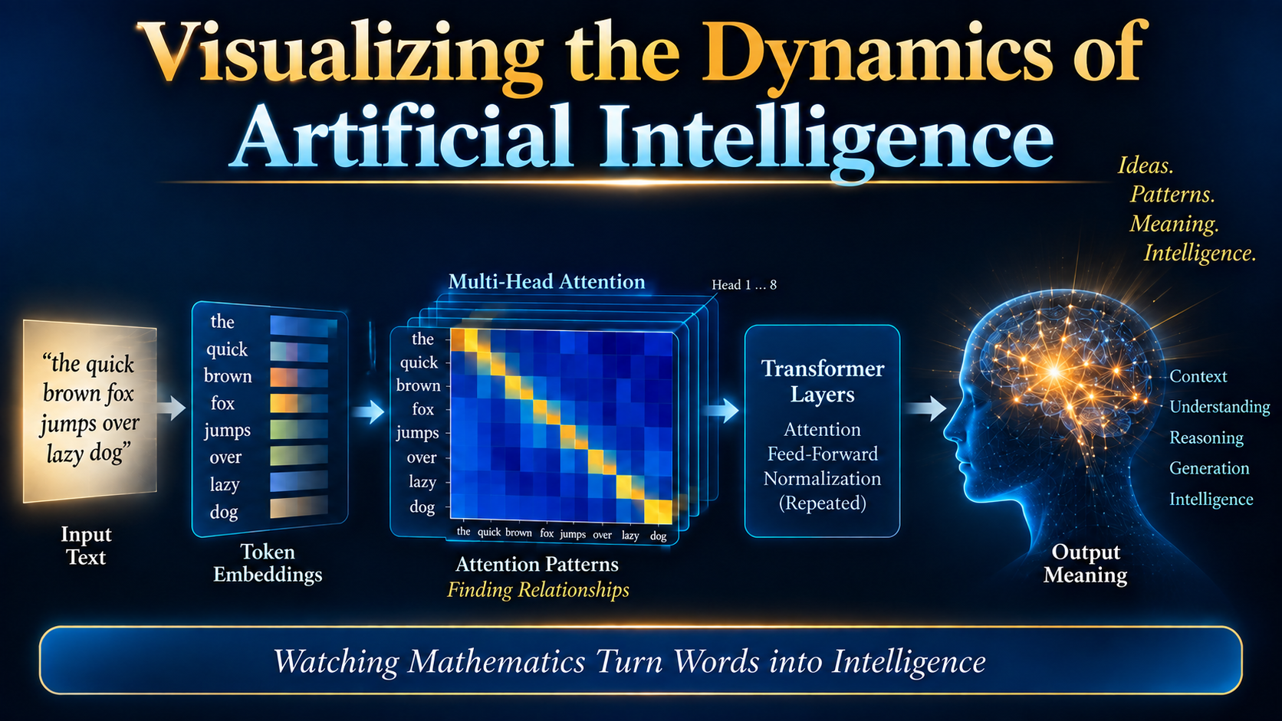

Slide 2
Presentation Roadmap
Visualizing the Dynamics of Artificial Intelligence
1
Personal Computing Journey — Slides 4–6
2
AI Origins & Computing Evolution — Slides 7–15
3
Neuron Foundations — Slides 16–17
4
Building a Perceptron — Step by Step — Slides 18–45
5
ELIZA & Early Conversational AI — Slides 46–55
6
Transformer Breakthrough & Laboratory Model — Slides 56–67
7
Words to Numerical Representation — Slides 68–76

Slide 3
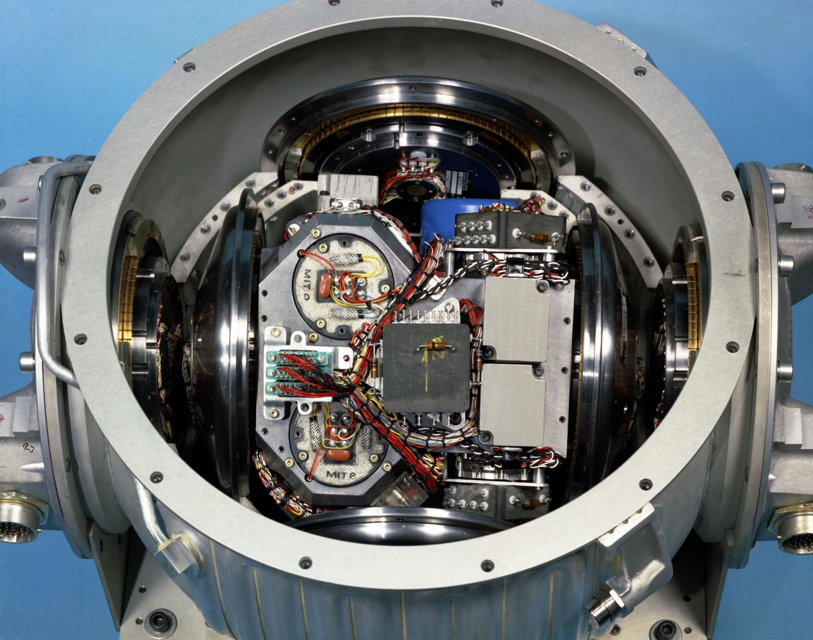
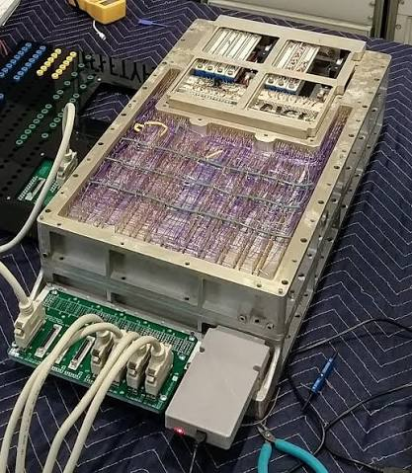
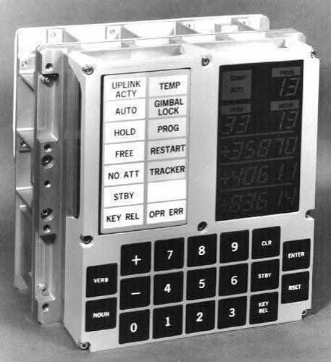
AC Electronics Sub-Contractor to NASA
Apollo LEM Guidance Computer
Apollo LEM Inertial Measurement Unit
Integrated
Circuits
LEM Display
And Keyboard

Slide 4
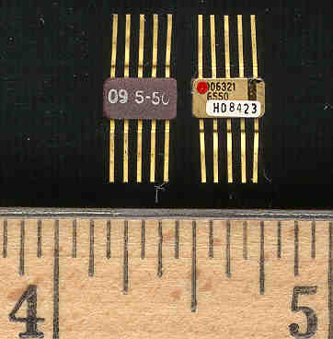
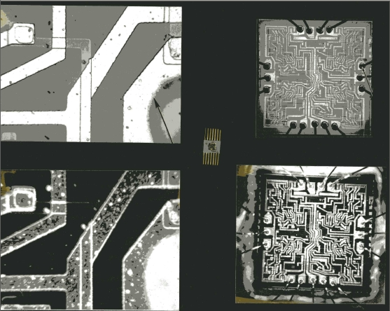

Guidance Computer Integrated Circuits
Analyst – Semiconductor/Integrated Circuit Analysis

Slide 5


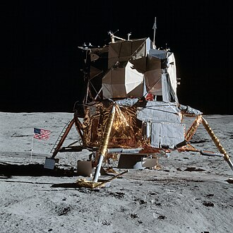
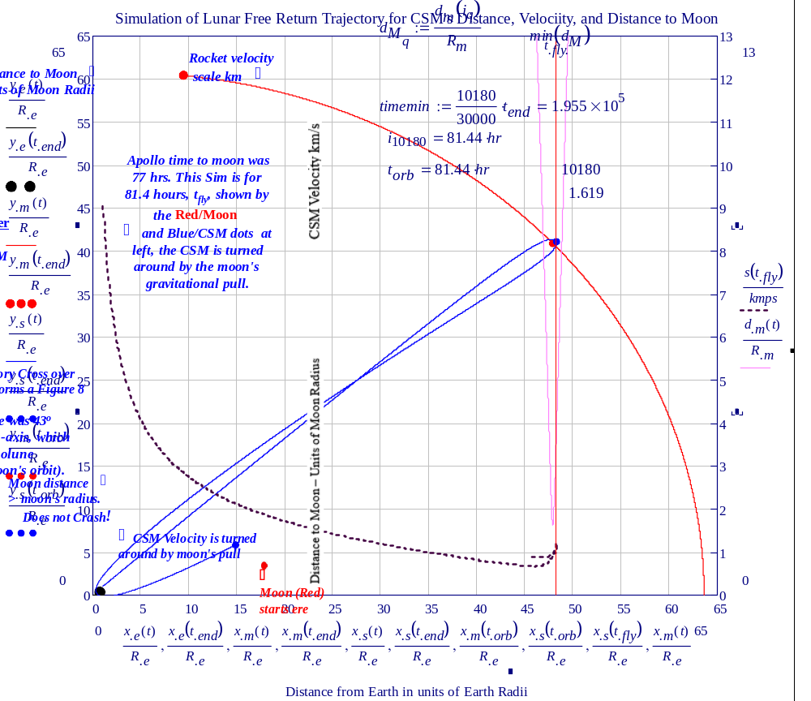
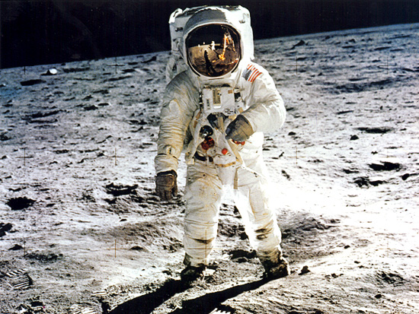
Lunar Excursion Module (LEM)
Inertial Measurement Unit -→

Slide 6
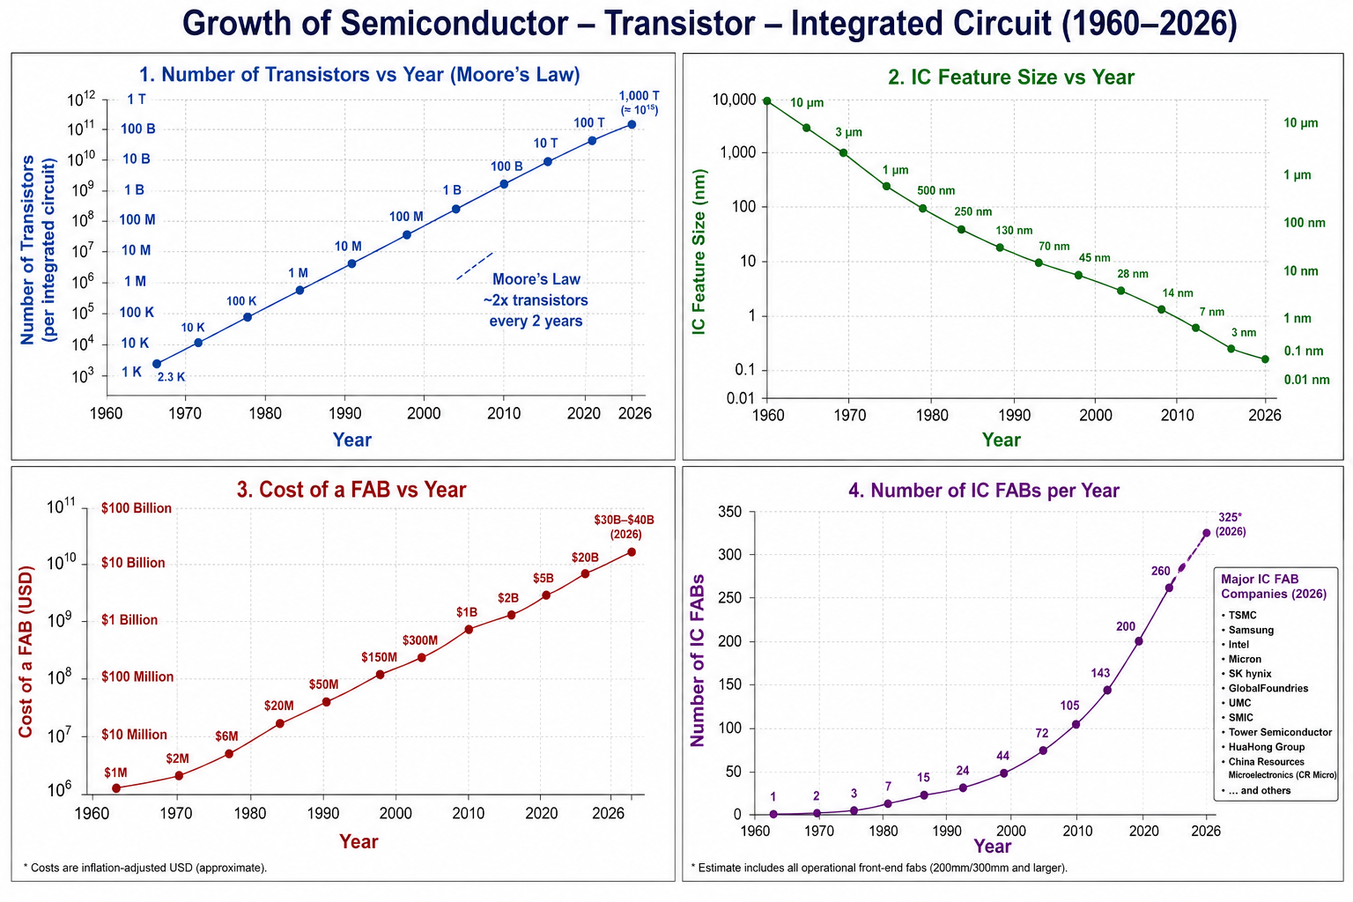
1970 AeroSpace Industry Collapses
AC Employees from 15,5000 to 1500
Offered Position at Main R & D
Senior Physicist (1977)
Semiconductor/Device Innovations
Optimization of Transistor Design
Major Automotive Technology
Math/Physics Based Analyses
First Professional Physics Model
1977 IEEE Power Electronics Specialists
Mathematical Analysis
“High Injection Region Analysis and Optimization of Power Transistors”
Retired: 2003 – 37 yrs. Senior Physicist
2010 Appointed Expert Physics: RITA
Review Work by NASA
2011 Start Physics Dept. Keiser U.
Taught Physics – Diagnostic Medical Sonograpy – 7 years
September 2026 Shell Point -WordLight
1,000,000X
Increase
80% of Market
TSMC
Samsung

Slide 7
History of Artificial Intelligence

Slide 8
ℕUMBER IS AN ETERNAL TRUTH
2 + 2 = 4
Before the universe existed, before matter, space, time, or the human mind,
mathematical truth did not depend on its discovery.
We did not invent number. We discovered it.
The Mathematical Platonist Perspective

Slide 9
The Discovery of ℕumber — A Turning Point in Human Thought
The decisive idea was not merely counting objects, but recognizing number as an abstraction.
3
● ● ●
◆ ◆ ◆
● ● ●
3 stones
3 animals
3 people
same abstract
quantity
Different objects can share the same number.
Once quantity could be separated from the things being counted,
Humans could reason about absent objects,
future events, comparisons, and relationships.

Slide 10
ℕumber Makes the Physical World Calculable
Technology advances when physical properties can be represented, compared, predicted, and controlled numerically.
MEASURE
COMPARE
PREDICT
DESIGN
CONTROL
Physics:
Measure (S,T,M, I)
greater • smaller • faster
position • motion • outcome
dimensions • tolerances
feedback • navigation • machines
A physical quantity becomes technologically useful
when it can be represented by a number.
Father of QC – Edward Deming : “What you can’t measure, you cannot improve.”
REALITY → MEASUREMENT → NUMBER → CALCULATION → ENGINEERING

Slide 11
The Critical Transformation — ℕumber Becomes Machine-Readable
A physical device can represent abstract numbers using discrete states.
NUMBER
BINARY
SWITCH
LOGIC
COMPUTER
3, 17, 1024
0 1 1 0 1
OFF / ON
AND • OR • NOT
automatic calculation
0
1
Two physical states can encode numbers — and numbers can encode information.
NUMBER → BINARY → TRANSISTOR STATES → DIGITAL COMPUTATION

Slide 12
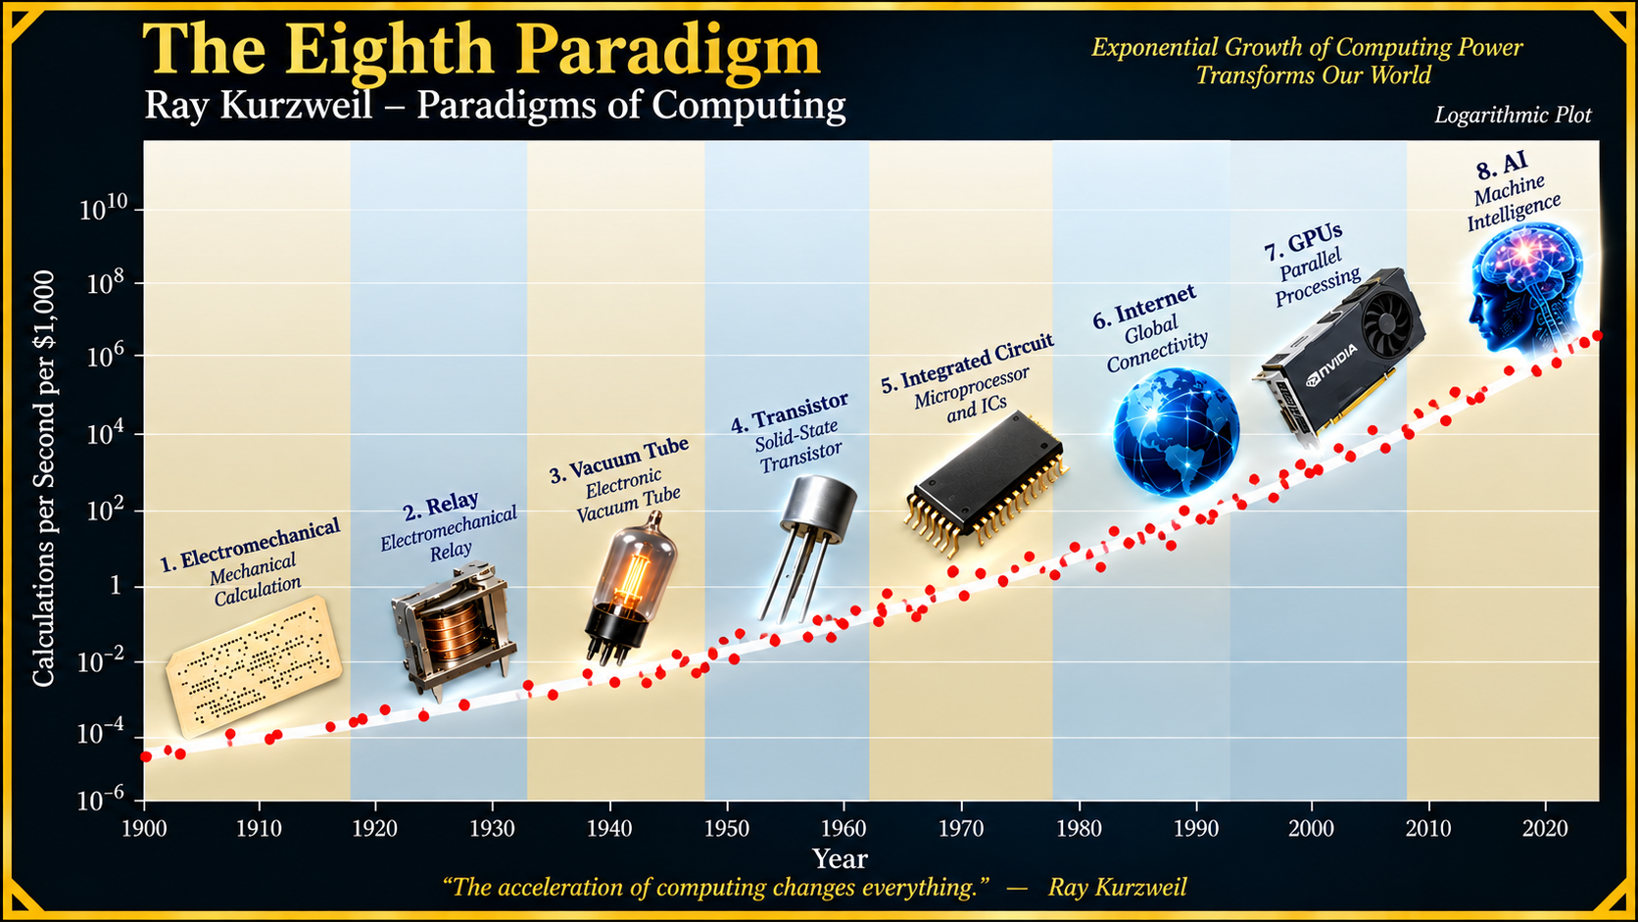
ℕumber
ℕumber is the Basis for Artificial Intelligence
Necessary Truth → Number → Mathematics → Physical Universe → Brain → Computer → AI

Slide 13
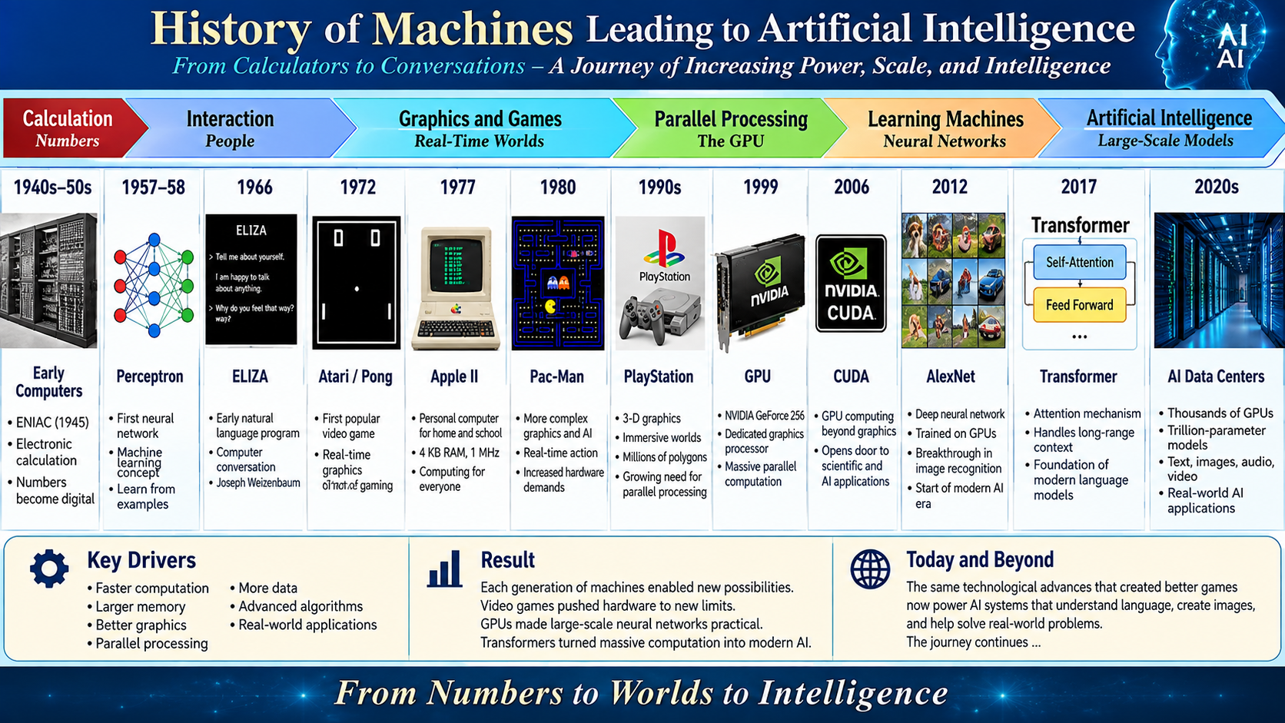
Nvidia

Slide 14
From Video Games to Artificial Intelligence
Graphics hardware evolves into a general parallel-computing engine
1972
1980
1993
1999
2006
2012
Today
Pong
Pac-Man
NVIDIA
founded
GeForce 256
GPU
CUDA
AlexNet
on GPUs
AI
accelerators
1999: GPU → 2006: programmable parallel computing → 2012: deep learning breakthrough
The hardware developed to render virtual worlds became ideal for the matrix mathematics of AI.

Slide 15
NVIDIA — Three Turning Points
1999
GPU
2006
CUDA
2012
AI
Graphics calculations become highly parallel.
GPU parallelism becomes programmable for general computation.
GPUs power AlexNet and help ignite modern deep learning.
Graphics → Accelerated Computing → Artificial Intelligence
The Market Value of NVIDIA is $5.4B
It is worth more than Apple, Microsoft and about 2X the value of Amazon

Slide 16
Early GPU Growth — More Transistors, More Parallel Work
NVIDIA historical transistor counts, 1995–2008 (logarithmic vertical scale)
1400M
1,000
754M
302M
222M
130M
Million
transistors
100
63M
22M
10
1M
1
1995
1999
2002
2003
2004
2005
2007
2008
1 million (NV1) → 22 million (GeForce 256) → 1.4 billion (GTX 200)

Slide 17
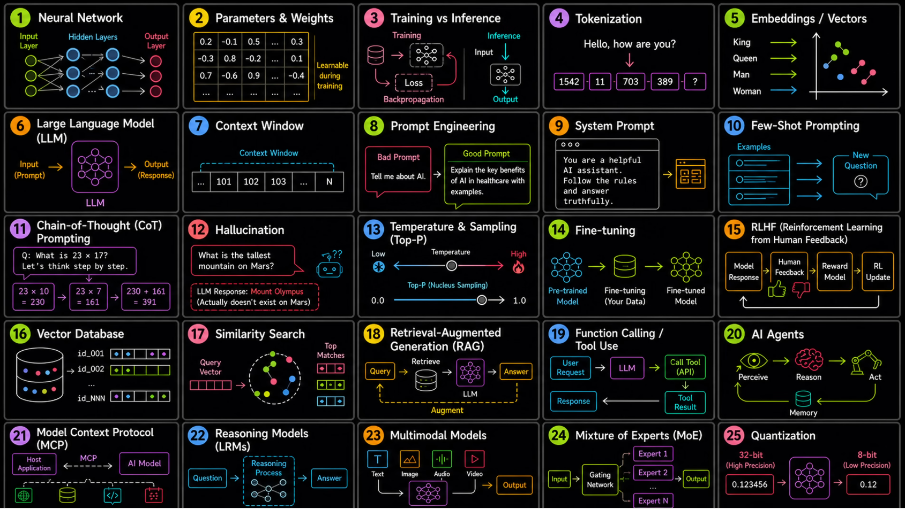
AI is Far Too Complicated to even cover 10 hours of lectures.
This shows 25 out a possible 100 Concepts in AI.

Slide 18
History of Machines Leading to Artificial Intelligence
Date | Name / Development | Contribution to AI
1943 | Warren McCulloch & Walter Pitts | Created a mathematical model of an artificial neuron - a conceptual beginning of neural networks.
1948-51 | Claude Shannon | Developed information theory and, entropy providing mathematics for measuring information and uncertainty.
1950 | Alan Turing | Proposed the Turing Test and framed the fundamental question of whether machines can exhibit intelligent behavior.
1956 | Dartmouth Workshop - John McCarthy et al. | Helped establish Artificial Intelligence as a named field of research.
1957-58 | Frank Rosenblatt - Perceptron | Developed an early learning neural network that adjusted weights from examples.
1966 | Joseph Weizenbaum – ELIZA | Demonstrated computer conversation using natural-language pattern matching.
1972 | Atari - Pong | Helped launch interactive video gaming and demand for increasingly capable real-time graphics hardware.
1978 | Apple II Computer – Eliza Program in Basic | About 120 lines of Basic Language Code for a Chat type program.
1980 | Pac-Man | Illustrates increasingly sophisticated real-time digital graphics represented and manipulated numerically as pixels.
1986 | Rumelhart, Hinton - Backpropagation | Popularized an effective method for training multilayer neural networks by propagating errors backward.
1990s | 3-D Video Games / PlayStation | Rapidly increased demand for specialized parallel graphics computation.
1999 | NVIDIA - GeForce 256 GPU | Popularized the GPU concept as a highly parallel processor for graphics calculations.
2006 | NVIDIA - CUDA | Made GPU parallel processing accessible for general scientific and numerical computation.
2012 | Krizhevsky, Sutskever & Hinton - AlexNet | Demonstrated the power of deep neural networks trained with GPUs for image recognition.
2013 | Tomas Mikolov et al. - Word2Vec | Represented words as learned multidimensional vectors in which semantic relationships emerge.
2014 | Bahdanau, Cho & Bengio - Attention | Introduced a practical neural attention mechanism that lets models emphasize relevant parts of an input.
2015 | Sennrich,- BPE for Neural Machine Translation | Applied subword tokenization to neural machine translation, helping models handle large vocabularies and rare words.
2017 | Vaswani et al. – Attention is All you Need: Transformer | Made self-attention central, enabling highly parallel processing of language sequences.
2018 | OpenAI - GPT-1 | Demonstrated generative pretraining followed by task-specific adaptation using a Transformer.
2019 | OpenAI - GPT-2 | Showed that scaling Transformer language models substantially improved coherent text generation.
2020 | OpenAI - GPT-3 | Demonstrated strong few-shot and in-context learning at 175 billion parameters.
2022 | ChatGPT | Brought conversational large-language-model interaction into widespread public use.
2020s | AI GPU Data Centers | Thousands of accelerators working in parallel make training and serving today's large AI systems practical.

Slide 19
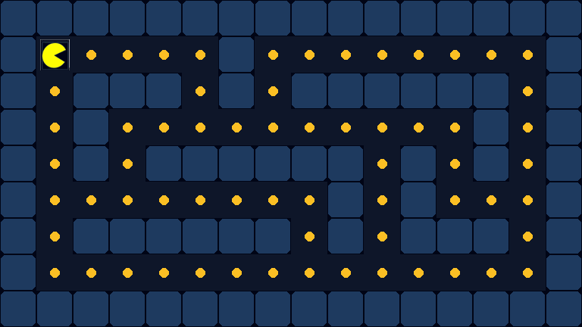
Foundational Use for GPU Graphics - GAMES: Pizza-Man Animation

Slide 20
1966 — ELIZA: A Machine Appears to Converse
A rule-based conversation — decades before the Transformer
MIT ARTIFICIAL INTELLIGENCE LABORATORY // ELIZA
ELIZA:
HOW DO YOU DO. PLEASE TELL ME YOUR PROBLEM.
CLICK → reveal the next exchange

Slide 21
1966 — ELIZA: A Machine Appears to Converse
A rule-based conversation — decades before the Transformer
MIT ARTIFICIAL INTELLIGENCE LABORATORY // ELIZA
ELIZA:
HOW DO YOU DO. PLEASE TELL ME YOUR PROBLEM.
YOU:
I AM WORRIED ABOUT ARTIFICIAL INTELLIGENCE.
CLICK → reveal the next exchange

Slide 22
1966 — ELIZA: A Machine Appears to Converse
A rule-based conversation — decades before the Transformer
MIT ARTIFICIAL INTELLIGENCE LABORATORY // ELIZA
ELIZA:
HOW DO YOU DO. PLEASE TELL ME YOUR PROBLEM.
YOU:
I AM WORRIED ABOUT ARTIFICIAL INTELLIGENCE.
ELIZA:
WHY ARE YOU WORRIED ABOUT ARTIFICIAL INTELLIGENCE?
CLICK → reveal the next exchange

Slide 23
1966 — ELIZA: A Machine Appears to Converse
A rule-based conversation — decades before the Transformer
MIT ARTIFICIAL INTELLIGENCE LABORATORY // ELIZA
ELIZA:
HOW DO YOU DO. PLEASE TELL ME YOUR PROBLEM.
YOU:
I AM WORRIED ABOUT ARTIFICIAL INTELLIGENCE.
ELIZA:
WHY ARE YOU WORRIED ABOUT ARTIFICIAL INTELLIGENCE?
YOU:
BECAUSE COMPUTERS ARE BECOMING VERY INTELLIGENT.
CLICK → reveal the next exchange

Slide 24
1966 — ELIZA: A Machine Appears to Converse
A rule-based conversation — decades before the Transformer
MIT ARTIFICIAL INTELLIGENCE LABORATORY // ELIZA
ELIZA:
HOW DO YOU DO. PLEASE TELL ME YOUR PROBLEM.
YOU:
I AM WORRIED ABOUT ARTIFICIAL INTELLIGENCE.
ELIZA:
WHY ARE YOU WORRIED ABOUT ARTIFICIAL INTELLIGENCE?
YOU:
BECAUSE COMPUTERS ARE BECOMING VERY INTELLIGENT.
ELIZA:
DO COMPUTERS CONCERN YOU?
CLICK → reveal the next exchange

Slide 25
1966 — ELIZA: A Machine Appears to Converse
A rule-based conversation — decades before the Transformer
MIT ARTIFICIAL INTELLIGENCE LABORATORY // ELIZA
ELIZA:
HOW DO YOU DO. PLEASE TELL ME YOUR PROBLEM.
YOU:
I AM WORRIED ABOUT ARTIFICIAL INTELLIGENCE.
ELIZA:
WHY ARE YOU WORRIED ABOUT ARTIFICIAL INTELLIGENCE?
YOU:
BECAUSE COMPUTERS ARE BECOMING VERY INTELLIGENT.
ELIZA:
DO COMPUTERS CONCERN YOU?
YOU:
SOMETIMES I THINK THEY UNDERSTAND ME.
CLICK → reveal the next exchange

Slide 26
1966 — ELIZA: A Machine that Appears to Converse
A rule-based conversation — decades before the Transformer
MIT ARTIFICIAL INTELLIGENCE LABORATORY // ELIZA
ELIZA:
HOW DO YOU DO. PLEASE TELL ME YOUR PROBLEM.
YOU:
I AM WORRIED ABOUT ARTIFICIAL INTELLIGENCE.
ELIZA:
WHY ARE YOU WORRIED ABOUT ARTIFICIAL INTELLIGENCE?
YOU:
BECAUSE COMPUTERS ARE BECOMING VERY INTELLIGENT.
ELIZA:
DO COMPUTERS CONCERN YOU?
YOU:
SOMETIMES I THINK THEY UNDERSTAND ME.
ELIZA:
WHY DO YOU THINK THEY UNDERSTAND YOU?
CLICK → reveal the next exchange

Slide 27

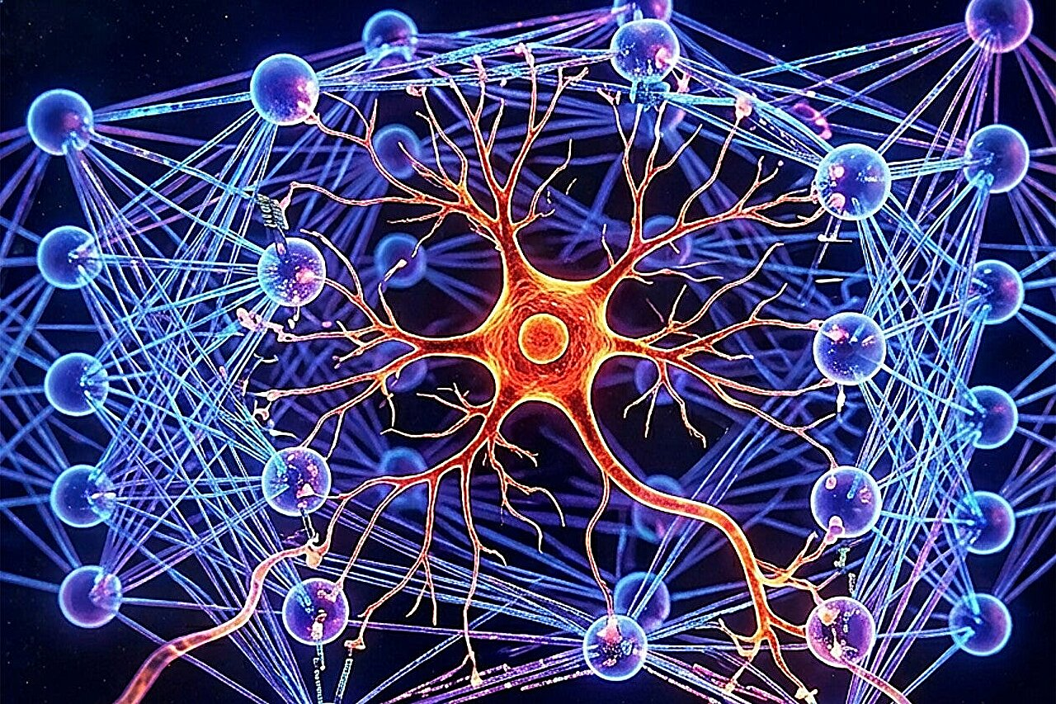
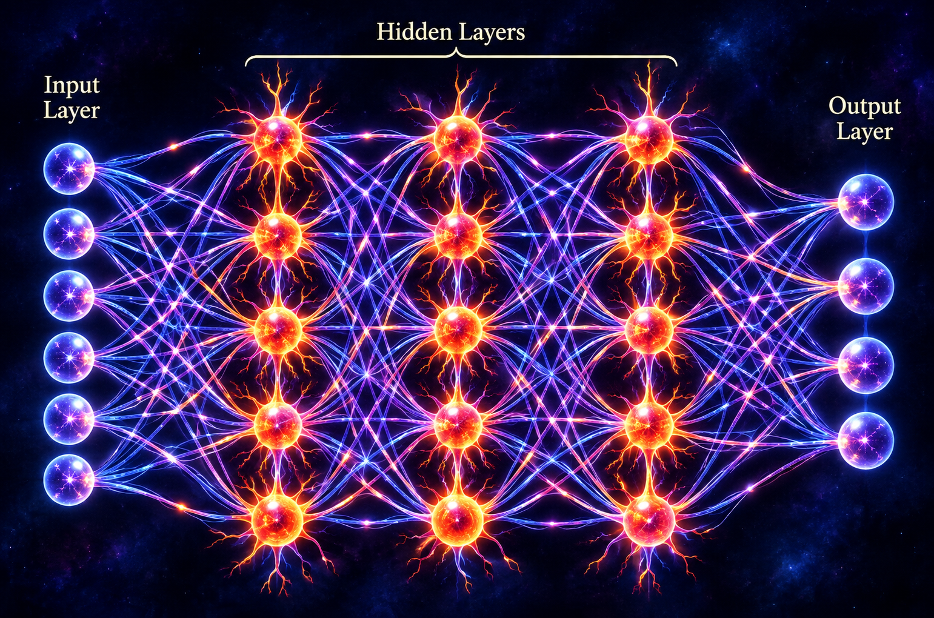
ℕeuron – ℕeural ℕetwork
We have 100 billion nerve cells firing in our brain, and
each one of them has 10,000 connections to other neurons.
Computational model of a Neuron
Neuronal activity is divided into three pieces:
simple interactions between one input and one output;
complex interactions involving multiple inputs; and
"latent noise," which arises from the inherent randomness of synapses and reaction spikes.

Slide 28
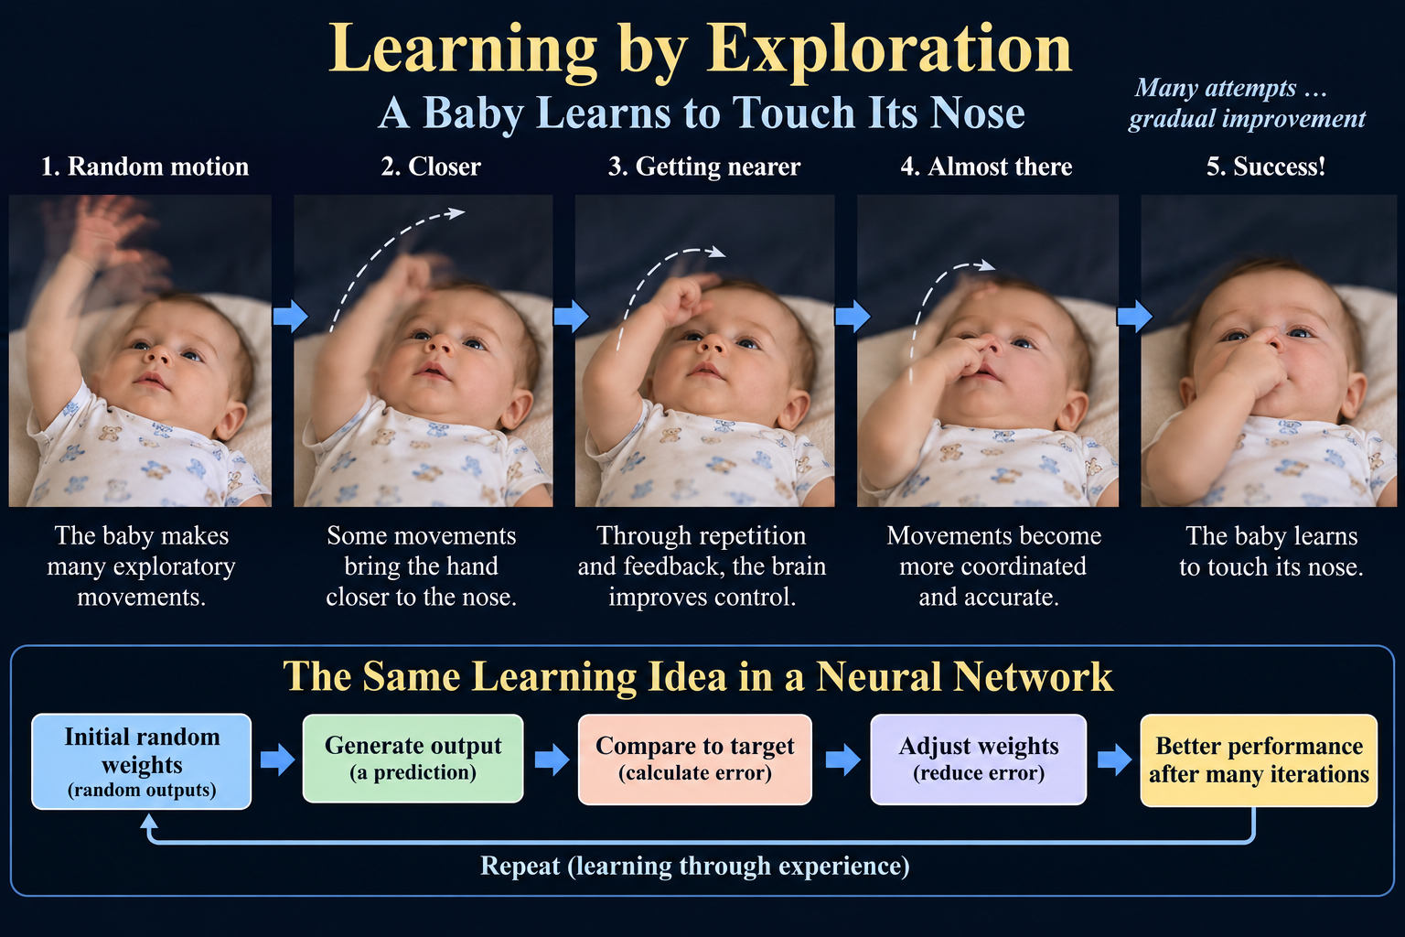

Slide 29
Feedback Changes the Brain
Experience helps refine the relationship between motor commands and movement
1
2
3
4
Motor command
➜
Movement
➜
Sensory feedback
➜
Adaptation
Brain sends a movement signal
Hand moves toward a target
Vision and touch report the result
Neural circuits gradually refine control
Repeat the cycle → increasingly coordinated movement
VISUALIZING THE DYNAMICS OF ARTIFICIAL INTELLIGENCE
2

Slide 30
A Neural Network Learns Through Repeated Updates
The computer measures prediction error and adjusts its weights
Input
Prediction
Loss
Update
➜
➜
➜
Training example
Network output
Measure the error
Adjust weights
Illustrative training loss
Repeated training steps →
Error is diminished
Unlike a baby, backpropagation computes mathematical gradients.
VISUALIZING THE DYNAMICS OF ARTIFICIAL INTELLIGENCE
3

Slide 31
From Exploratory Movement to Neural-Network Training
A useful analogy—without claiming biological and artificial learning are identical
DEVELOPING MOTOR CONTROL
ARTIFICIAL NEURAL NETWORK
Exploratory movement
Initial prediction
Sensory feedback
Calculated loss
Neural adaptation
Weight update
Improved coordination
Improved prediction
Shared principle: feedback changes future behavior.
VISUALIZING THE DYNAMICS OF ARTIFICIAL INTELLIGENCE
4

Slide 32
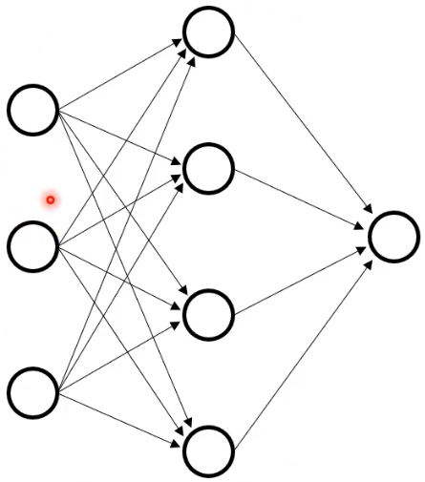
Building a Perceptron — Step by Step
Neural Network
Neural Network

Slide 33
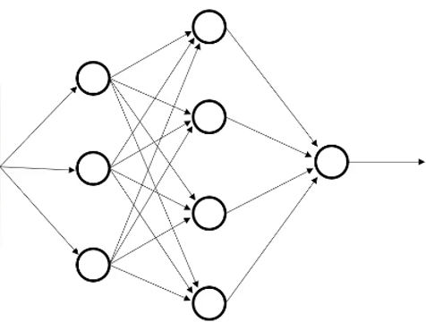


Slide 34
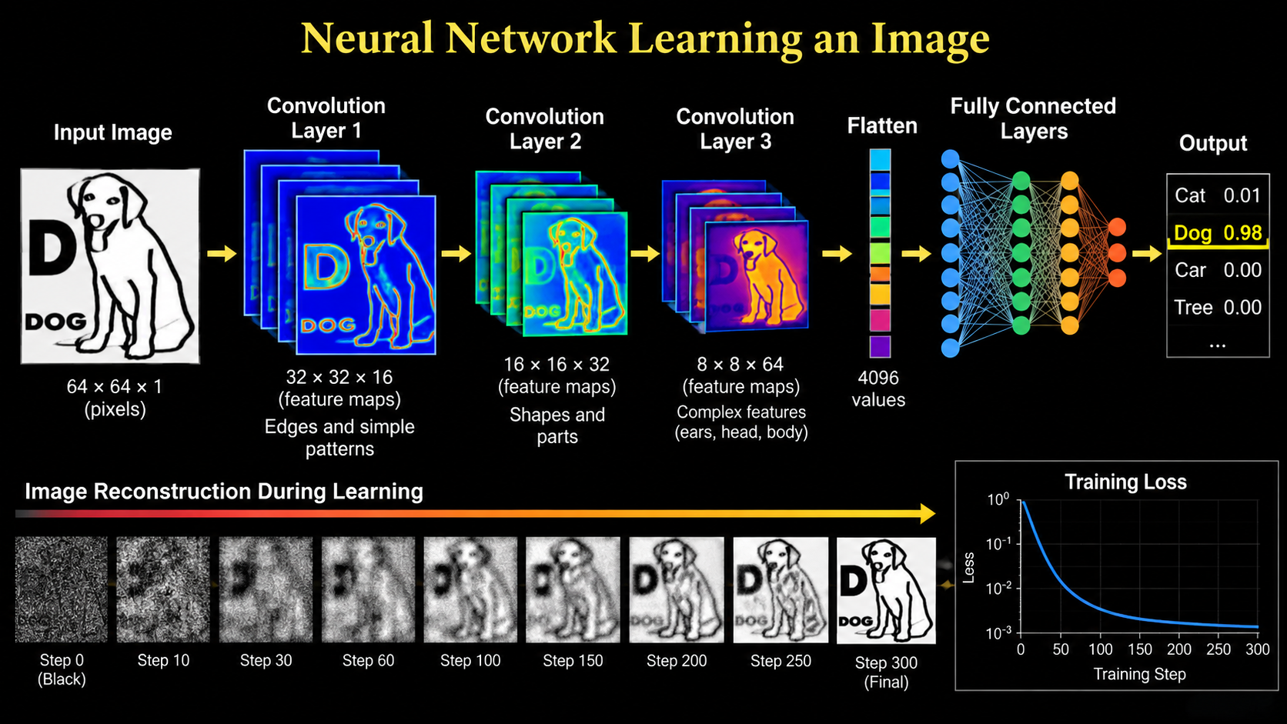

Slide 35
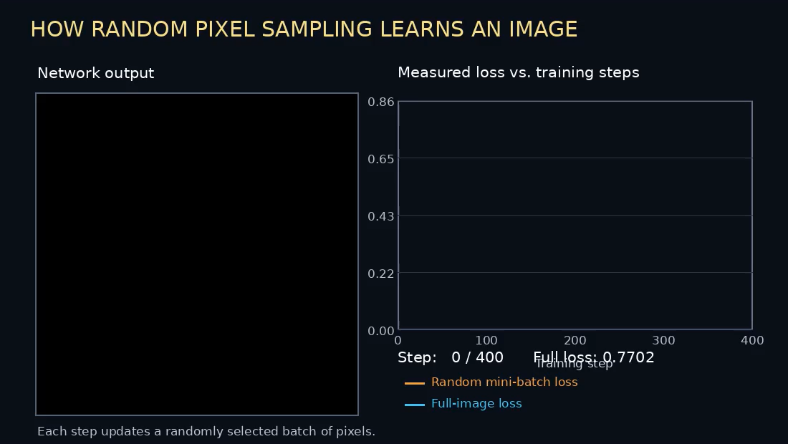

Slide 36
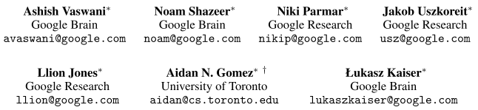
Attention Is All You Need
"Attention Is All You Need"
is a 2017 research paper on machine learning authored by eight scientists and engineers working at Google. It is one of the most heavily cited academic papers in the history of computer science and artificial intelligence.
The paper introduced the Transformer architecture, which replaced slow sequential processing with self-attention mechanisms.
Why It Matters
Foundation of Modern AI: It is the underlying technology powering large language models like ChatGPT, Claude, and Gemini.
Industry Shift: By enabling parallelized training, it made large-scale machine learning vastly faster and more efficient, rendering older recurrent neural networks largely obsolete
The dominant sequence transduction models are based on complex recurrent or
convolutional neural networks that include an encoder and a decoder. The best
performing models also connect the encoder and decoder through an attention
mechanism. We propose a new simple network architecture, the Transformer,
based solely on attention mechanisms, dispensing with recurrence and convolutions entirely. Experiments on two machine translation tasks show these models to be superior in quality while being more parallelizable and requiring significantly less time to train. Our model achieves 28.4 BLEU on the WMT 2014 English-to-German translation task, improving over the existing best results, including ensembles, by over 2 BLEU. On the WMT 2014 English-to-French translation task, our model establishes a new single-model state-of-the-art BLEU score of 41.8 after training for 3.5 days on eight GPUs, a small fraction of the training costs of the best models from the literature. We show that the Transformer generalizes well to other tasks by applying it successfully to English constituency parsing both with large and limited training data.
BLEU stands for Bilingual Evaluation Understudy.

Slide 37
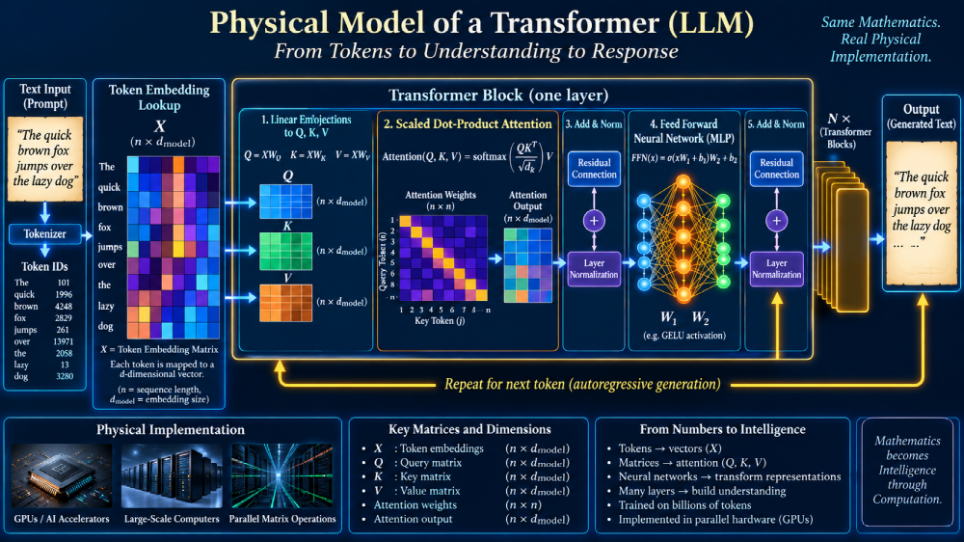

Slide 38
LLM Transformer Laboratory Model — What the Python Code Does
A compact, visible model for watching QKV attention and training evolve
X Matrix
Q • K • V
8 Heads
Attention
FFN
Output
Token
80 × 8
8 token vectors
WQ, WK, WV
80 × 80
10 dimensions
per head
QKᵀ/√10
+ softmax
80 → 160 → 80
80 logits
→ probabilities
argmax
→ new X
MODEL SCALE
120-STEP TRAINING LOOP
SAVED VALUES & GRAPHS
1. Last token becomes Query
2. Compute Q, K, V for 8 heads
3. Calculate attention weights
4. Residual + LayerNorm + FFN
5. Softmax → 80 probabilities
6. Measure error and update weights
7. Predicted token enters context
8 × 120 = 960 head evaluations
Tens of millions of execution cycles
Saved each step:
Entropy • Loss • Ptarget • Pmax
Attention entropy • Adiag
8 attention weights • positional bias
KL divergence
Graphs:
Entropy • Loss • Phase trajectory
Probabilities • Attention entropy
Adiag • Mean attention • Heatmap
KL divergence • Positional bias
Embedding N = 80
Context = 8 tokens
Heads = 8
Head dimension = 10
Feed-forward = 160
Training = 120 steps
Target token = 10
Learnable positional bias
324 Lines of Code
Purpose: Expose the internal mathematics so You can watch a small Transformer learn.

Slide 39
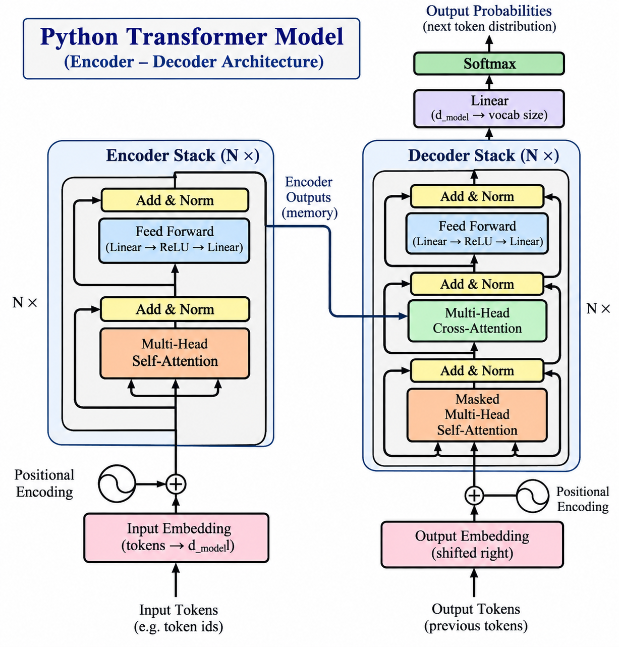

Slide 40

1. Low Entropy — Ordered Structure
The intact vase represents a highly organized state.
Intact vase:
low physical disorder
LLM analogy:
a concentrated, organized probability pattern
Entropy is best described here as uncertainty or disorder.
Low entropy = fewer plausible arrangements
Roadmap 6

Slide 41

2. High Entropy — Many Possibilities
When the vase shatters, the possible arrangements multiply.
Shattered pieces:
high disorder
LLM analogy:
many possible token outputs compete
Token-output entropy measures uncertainty in the output probabilities.
High entropy = many plausible choices
Roadmap 6

Slide 42
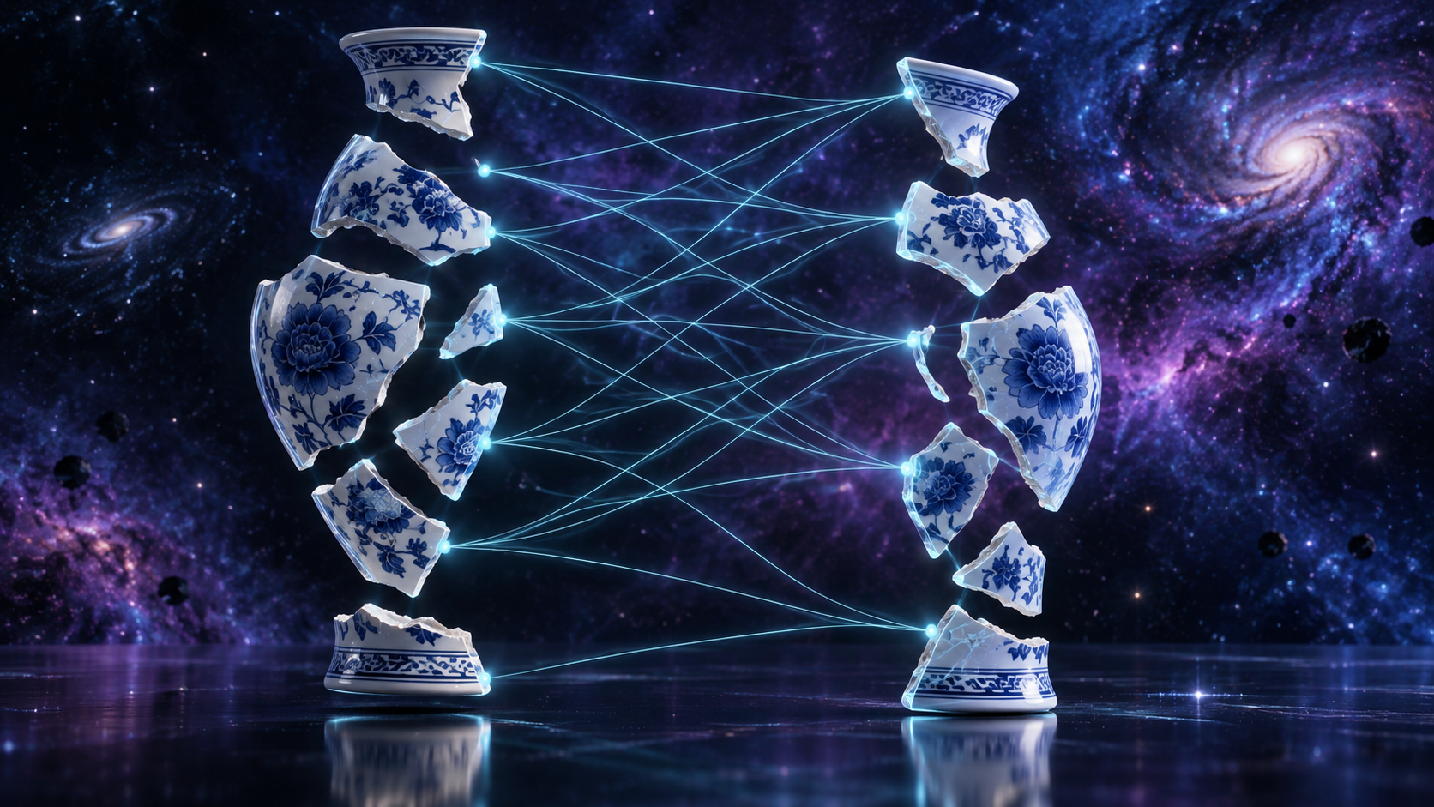
3. Attention — Compare Each Piece With Others
The system scores which pieces seem to fit together.
Piece-to-piece comparison
Transformer analogy:
Q compares with K
Softmax turns scores into relative attention weights.
QKᵀ → scores
Softmax → attention
Roadmap 6

Slide 43
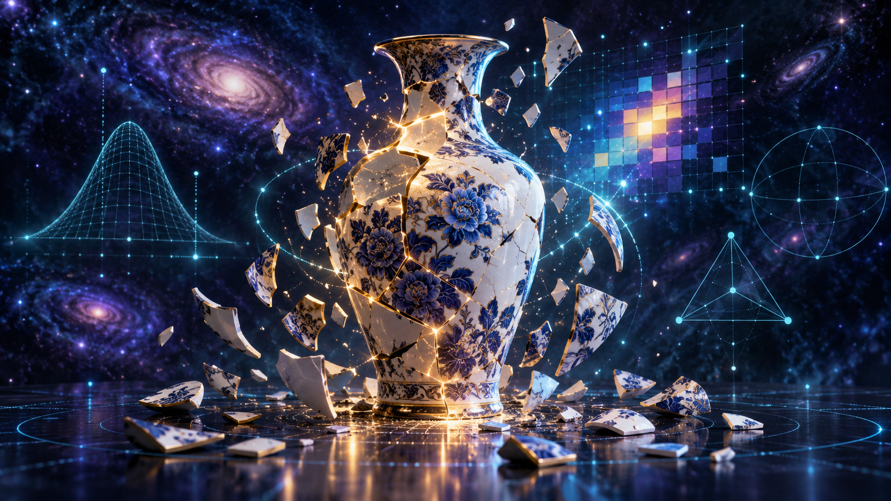
4. Learning — From Uncertainty to Structure
Training adjusts weights so useful relationships become stronger.
The vase begins to regain structure.
LLM analogy:
weights change so better relationships receive more attention.
Htrain falling means the output distribution is becoming more certain.
Loss ↓ Htrain ↓ Ptarget ↑
Roadmap 6

Slide 44
From a Broken Vase to Quantified Entropy
A teaching analogy connecting 1,000 unresolved possibilities to H = ln(N)
SHATTERED VASE
1,000 unresolved possibilities
H = ln(1000) = 6.91
REASSEMBLY / TRAINING
Each step eliminates possibilities
Structure increases
NEARLY RESOLVED
H ≈ 0.20
N effective = e^0.2 ≈ 1.22
→
→
The number of physical pieces is NOT the entropy.
For the illustration, the pieces represent equally plausible unresolved arrangements or possibilities.
N≈1,000
H=6.91
N≈403
H=6.0
N≈148
H=5.0
N≈55
H=4.0
N≈20
H=3.0
N≈7
H=2.0
N≈2.7
H=1.0
N≈≈1
H=0.2
N effective = eᴴ ⇄ H = ln(N effective)
GIF interpretation: Step 0 ≈ 1,000 possibilities → Step 100 ≈ one strongly preferred possibility
Illustrative vase-derived entropy mapping — not measured Python Htrain data.
Roadmap 6

Slide 45
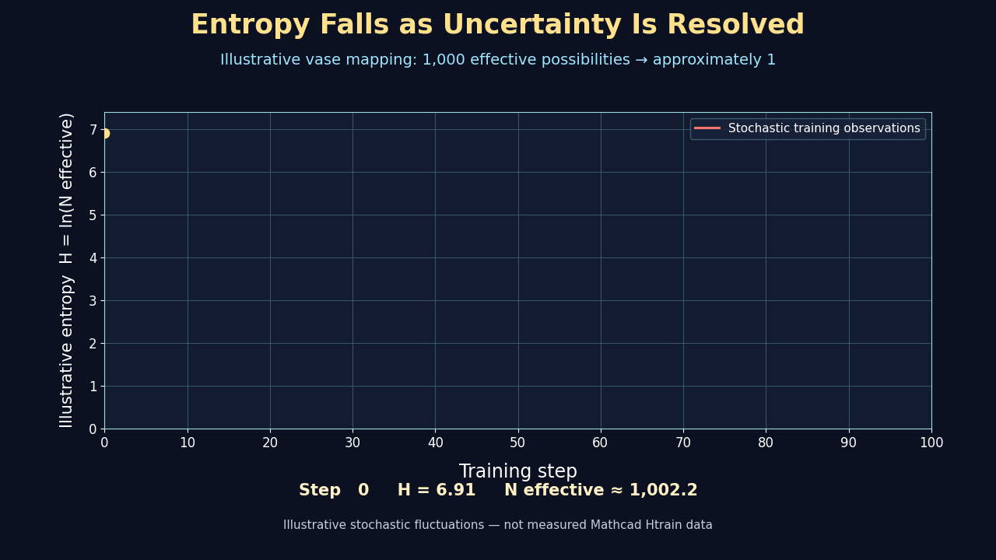

Slide 46
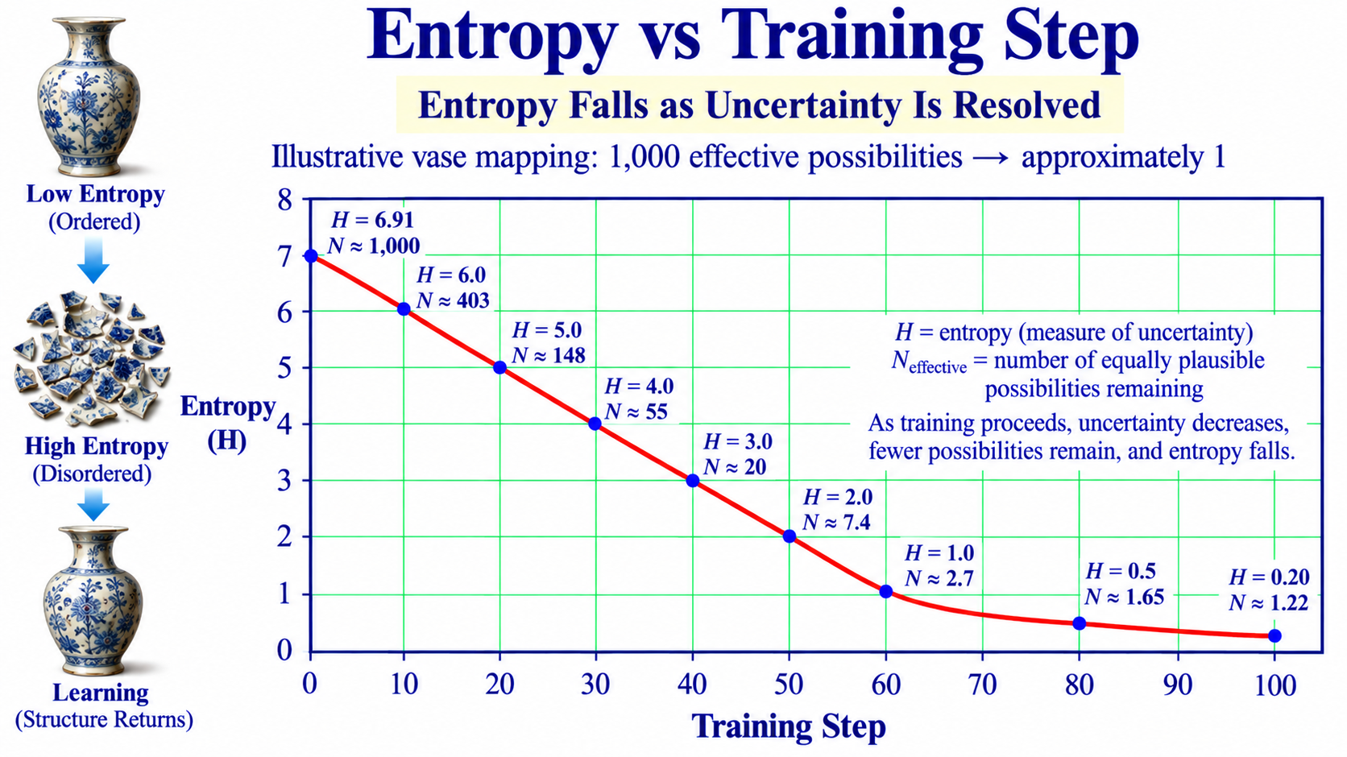
Roadmap 6

Slide 47
LLM Transformer Laboratory Model — What the Python Code Does
A compact, visible model for watching QKV attention and training evolve
X Matrix
Q • K • V
8 Heads
Attention
FFN
Output
Token
80 × 8
8 token vectors
WQ, WK, WV
80 × 80
10 dimensions
per head
QKᵀ/√10
+ softmax
80 → 160 → 80
80 logits
→ probabilities
argmax
→ new X
MODEL SCALE
120-STEP TRAINING LOOP
SAVED VALUES & GRAPHS
1. Last token becomes Query
2. Compute Q, K, V for 8 heads
3. Calculate attention weights
4. Residual + LayerNorm + FFN
5. Softmax → 80 probabilities
6. Measure error and update weights
7. Predicted token enters context
8 × 120 = 960 head evaluations
Tens of millions of execution cycles
Saved each step:
Entropy • Loss • Ptarget • Pmax
Attention entropy • Adiag
8 attention weights • positional bias
KL divergence
Graphs:
Entropy • Loss • Phase trajectory
Probabilities • Attention entropy
Adiag • Mean attention • Heatmap
KL divergence • Positional bias
Embedding N = 80
Context = 8 tokens
Heads = 8
Head dimension = 10
Feed-forward = 160
Training = 120 steps
Target token = 10
Learnable positional bias
324 Lines of Code
Purpose: Expose the internal mathematics so You can watch a small Transformer learn.

Slide 48
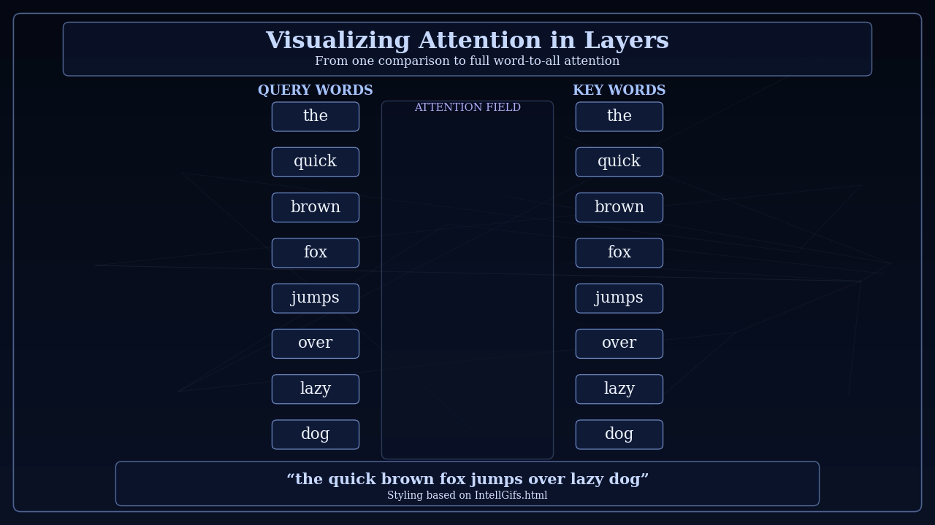
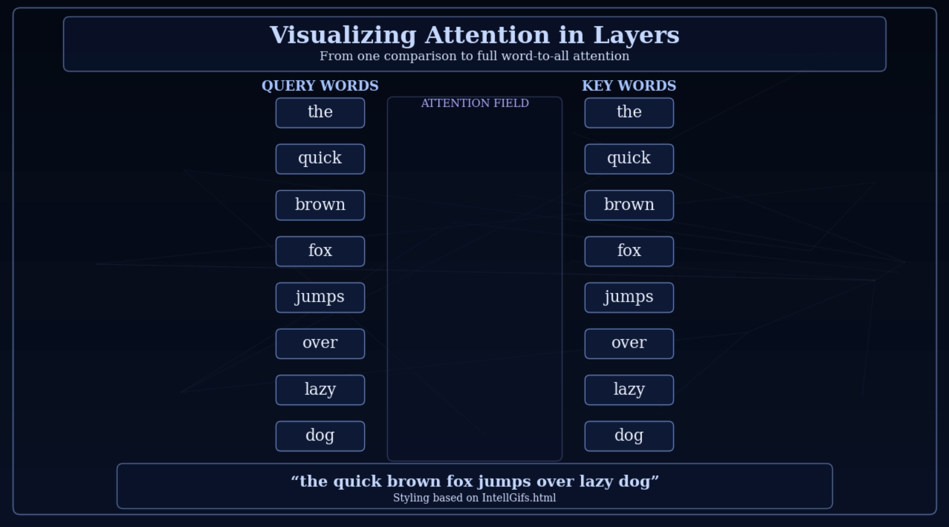
Visualizing Attention in Layers
Roadmap 9

Slide 49
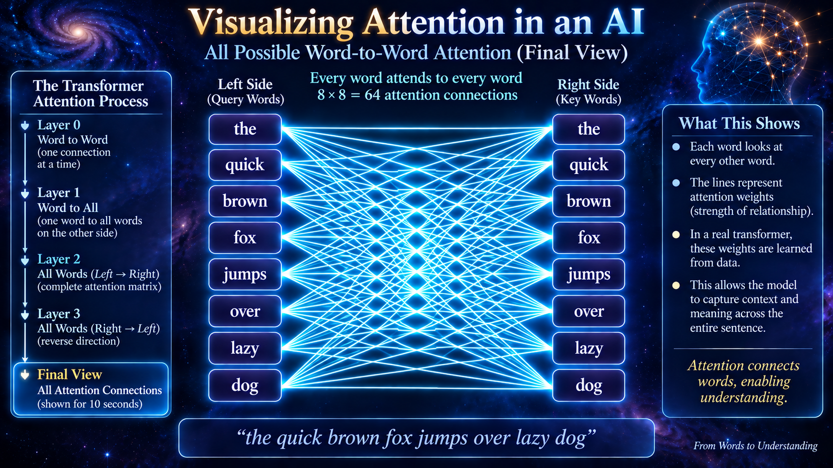
Roadmap 9

Slide 50
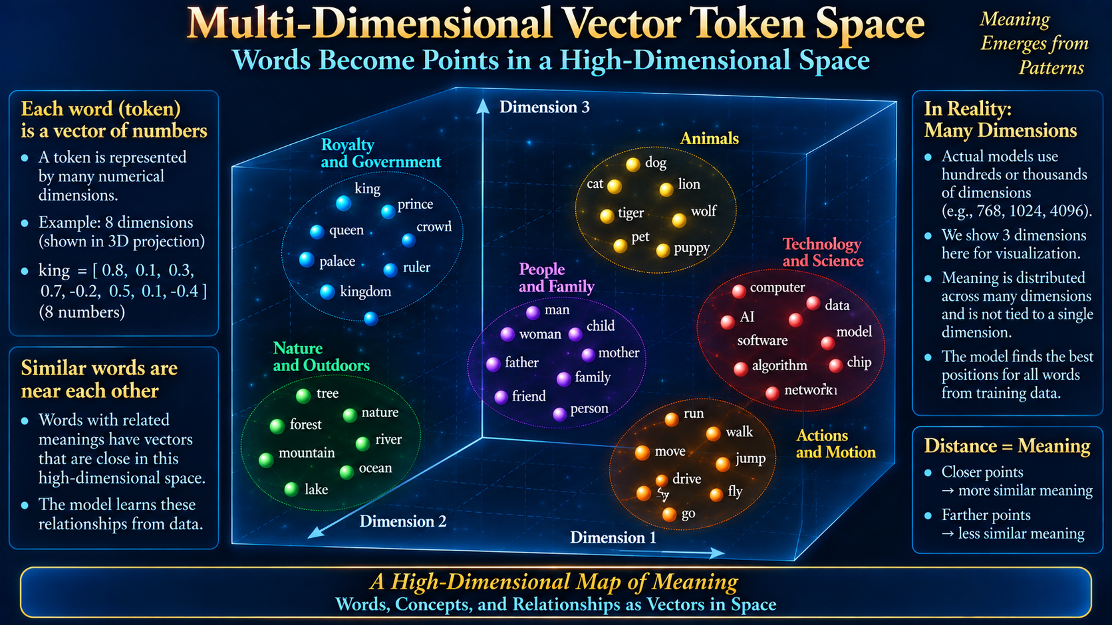
Roadmap 3

Slide 51
The Purpose of this work is Educational:
to make the hidden mathematics visible.
Small enough to see —
faithful enough to teach
Roadmap 9

Slide 52
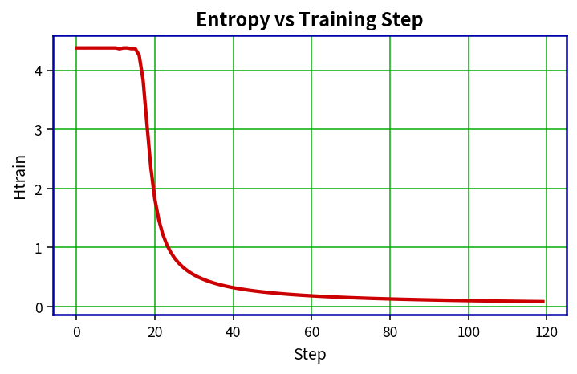
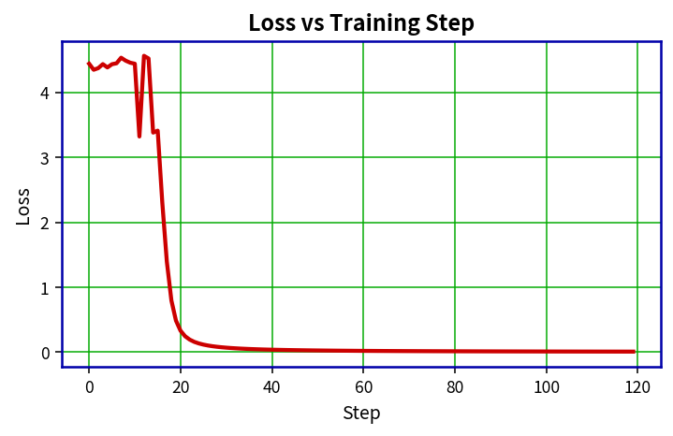
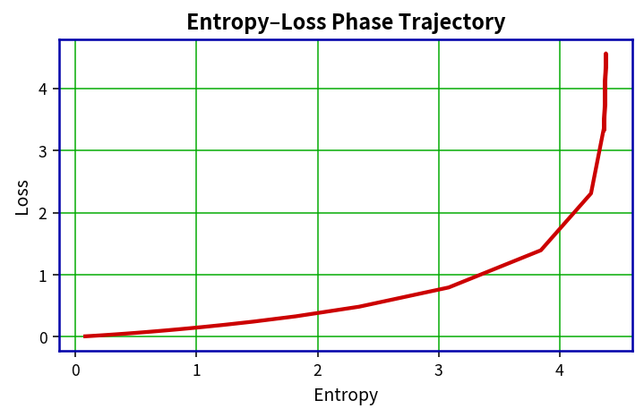
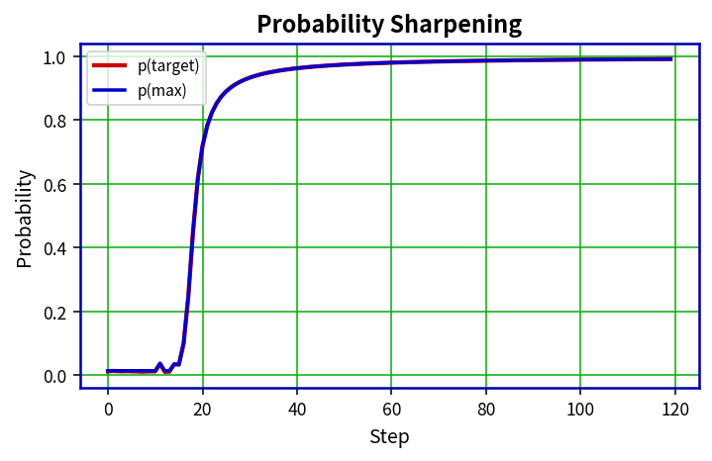
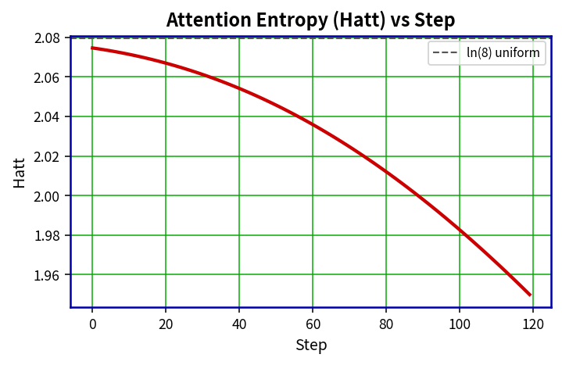
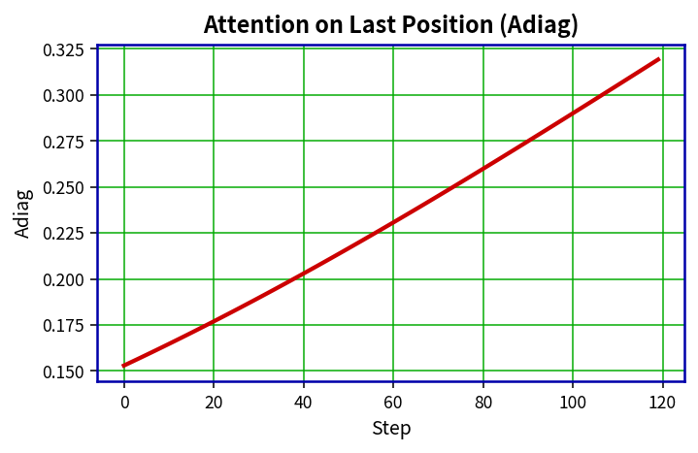
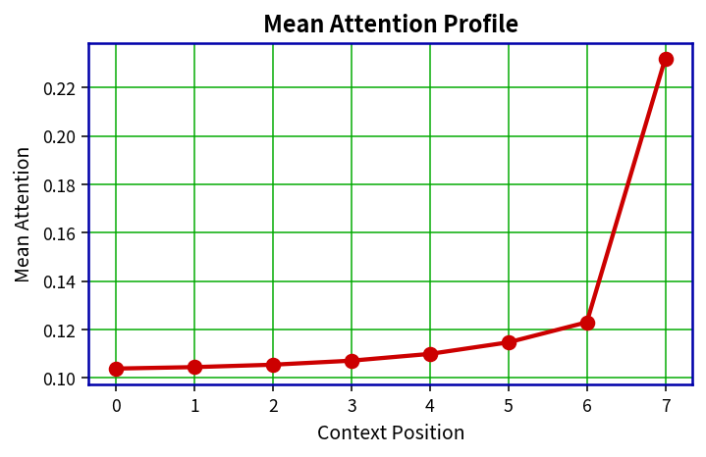
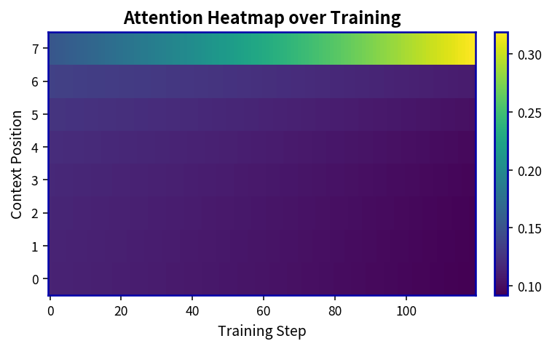
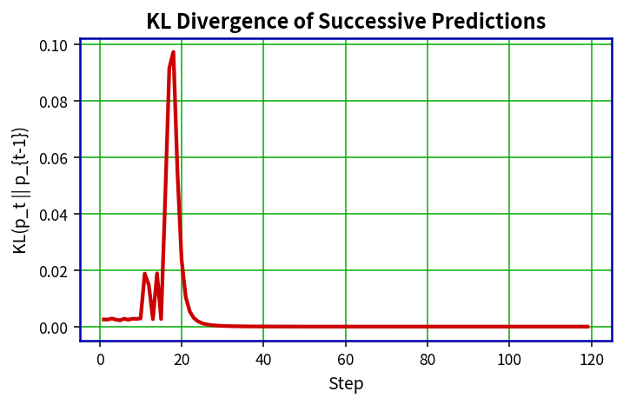
Multi-Head QKV Transformer — Training Plots
Entropy vs Step
Loss vs Step
Entropy–Loss Phase
Ptarget / Pmax
Attention Entropy (Hatt)
Adiag (last pos)
Mean Attention Profile
Attention Heatmap
KL Divergence

Slide 53
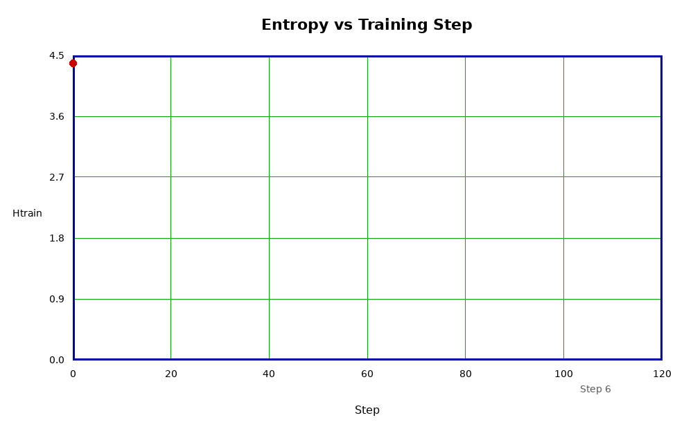
1. Output Entropy — Uncertainty in the Prediction
WHAT IT IS
Entropy measures how spread out the model’s output probabilities are.
WHAT TO WATCH
Watch the curve fall as the output becomes less uncertain.
AI MEANING
The model is becoming more decisive about its prediction.
0–120 training-step scale • grid every 20 steps • animation slowed 30%

Slide 54
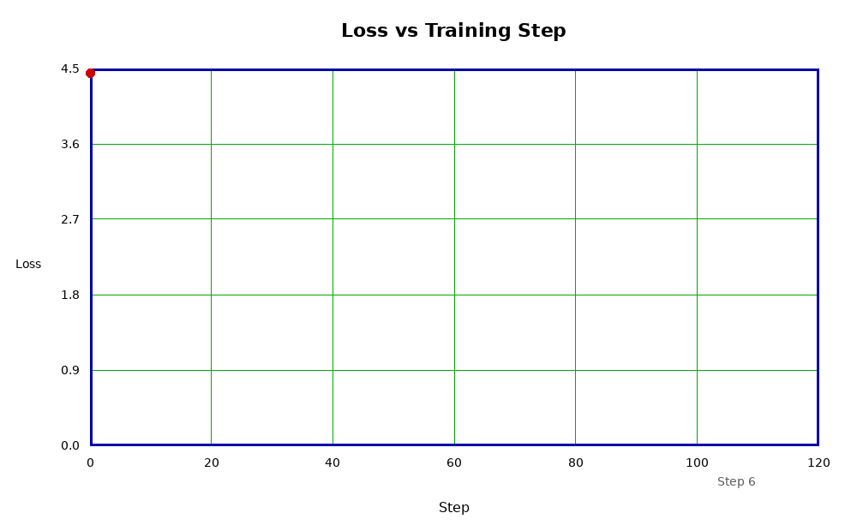
2. Loss — How Wrong Is the Model?
WHAT IT IS
Loss is the training error: here, −ln[p(target)].
WHAT TO WATCH
Watch loss fall as the desired target receives more probability.
AI MEANING
Weight updates are improving the desired prediction.
0–120 training-step scale • grid every 20 steps • animation slowed 30%

Slide 55
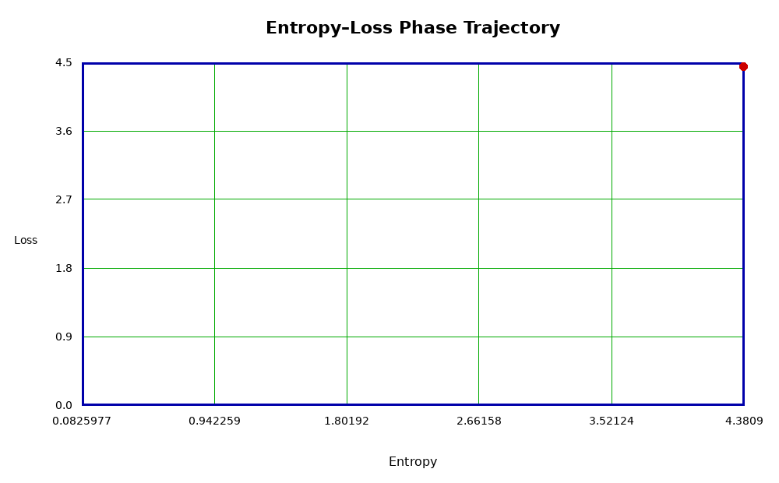
3. Entropy–Loss Phase — The Learning Path
WHAT IT IS
Loss is plotted against entropy rather than against training step.
WHAT TO WATCH
Watch the trajectory move as error and uncertainty change together.
AI MEANING
It is a compact portrait of the model’s changing training state.
0–120 training-step scale • grid every 20 steps • animation slowed 30%

Slide 56
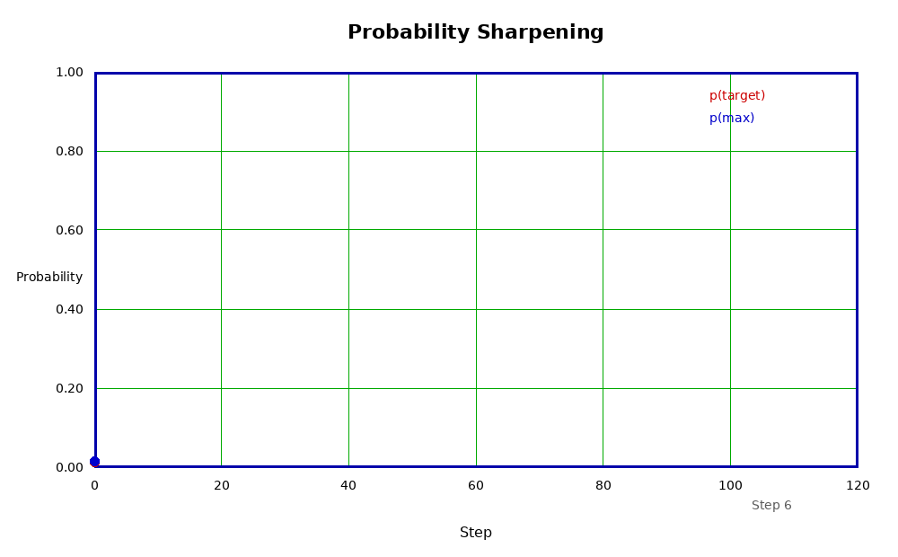
4. p(target) / p(max) — Probability Sharpening
WHAT IT IS
p(target) is the desired answer; p(max) is the model’s largest probability.
WHAT TO WATCH
Watch the target probability rise toward the dominant prediction.
AI MEANING
Training makes the desired candidate increasingly dominant.
0–120 training-step scale • grid every 20 steps • animation slowed 30%

Slide 57
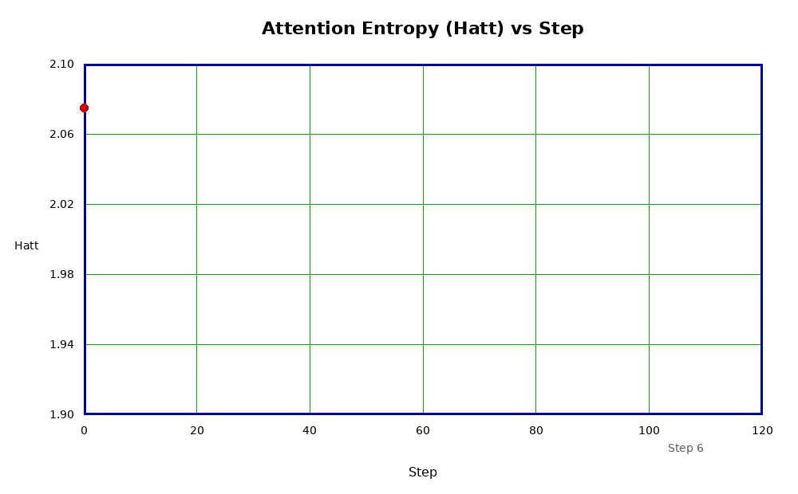
5. Attention Entropy — Is Attention Focused?
WHAT IT IS
Hatt measures how broadly attention is distributed over the 8 context positions.
WHAT TO WATCH
Watch Hatt fall as attention becomes more concentrated.
AI MEANING
The model is learning to focus rather than spread attention uniformly.
0–120 training-step scale • grid every 20 steps • animation slowed 30%

Slide 58
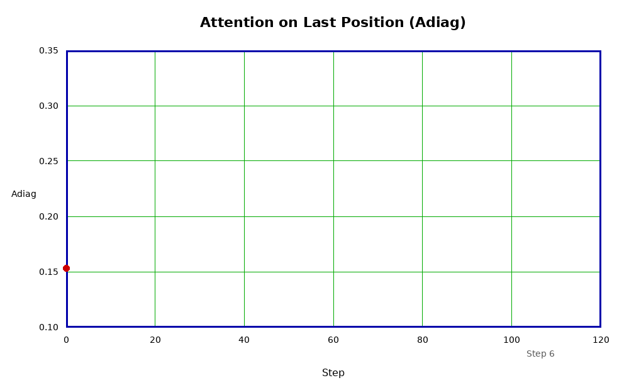
6. Adiag — Attention on the Last Position
WHAT IT IS
Adiag is the average attention weight assigned to the final context position.
WHAT TO WATCH
Watch it rise during training.
AI MEANING
In this teaching model, positional bias is intentionally encouraged toward the last position.
0–120 training-step scale • grid every 20 steps • animation slowed 30%

Slide 59
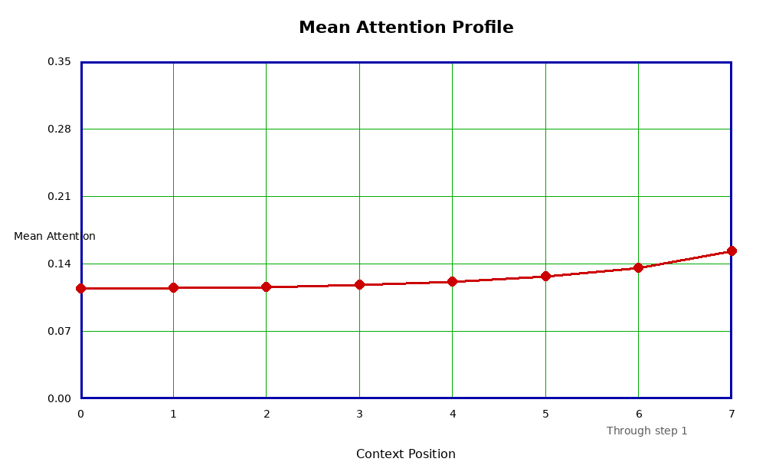
7. Mean Attention Profile — Where Does It Look?
WHAT IT IS
Eight values show average attention at each context position.
WHAT TO WATCH
Watch the profile reshape as additional training steps are included.
AI MEANING
It reveals which context positions the model emphasizes overall.
0–120 training-step scale • grid every 20 steps • animation slowed 30%

Slide 60
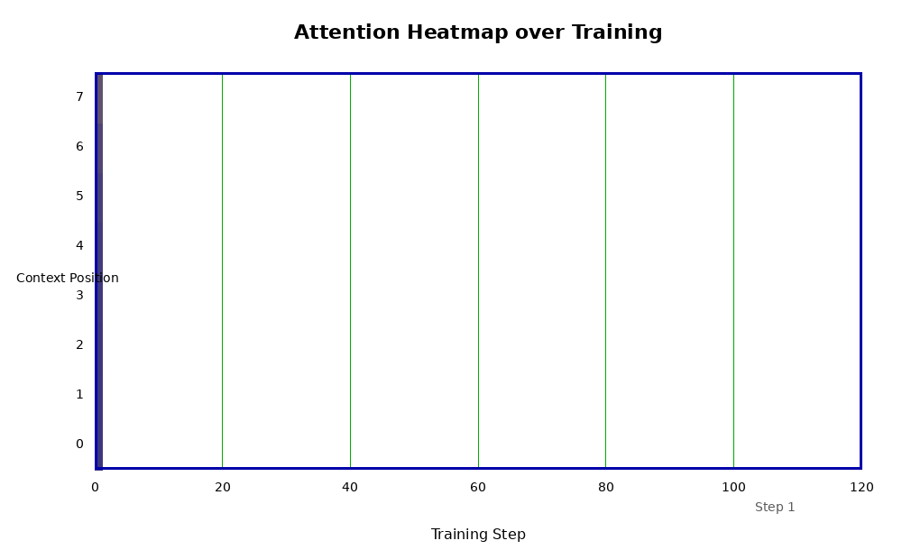
8. Attention Heatmap — Attention Evolving
WHAT IT IS
Rows are context positions; columns are training steps; intensity is attention weight.
WHAT TO WATCH
Watch the image grow left-to-right as attention reorganizes.
AI MEANING
This gives a direct visual impression of attention changing during learning.
0–120 training-step scale • grid every 20 steps • animation slowed 30%

Slide 61
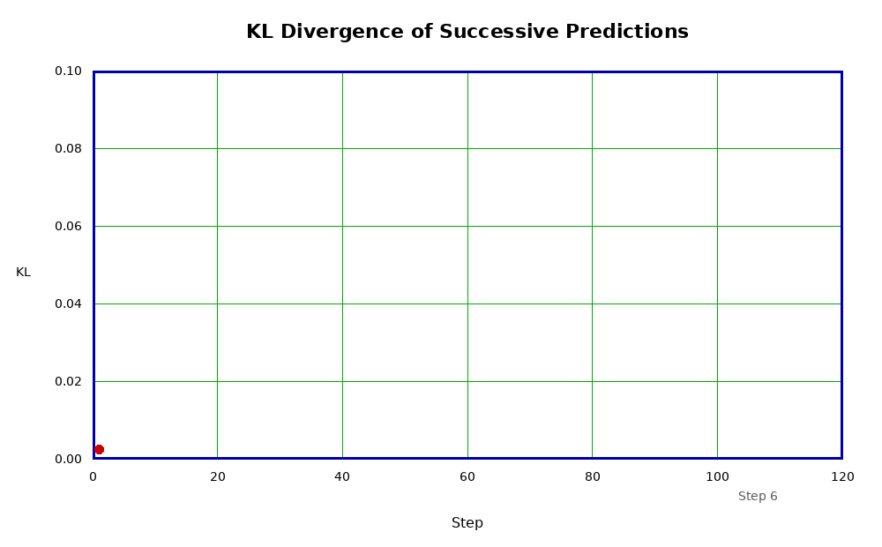
9. KL Divergence — How Much Did the Prediction Change?
WHAT IT IS
KL divergence compares one step’s output distribution with the preceding step.
WHAT TO WATCH
Spikes mean a larger change; small values mean consecutive predictions are similar.
AI MEANING
It shows whether learning is making large or small changes to the output distribution.
0–120 training-step scale • grid every 20 steps • animation slowed 30%

Slide 62


Slide 63
END OF PRESENTATION
THE FOLLOWING MATERIAL
IS BACKGROUND.
IT IS MORE MATH INTENSIVE

Slide 67
What Does LLM Learning Mean?
A large Language Model (LLM) is a type of AI that tries to predict
the next word/token In a sentence based on what came before it.
DATA
PATTERNS
RELATIONSHIPS
GENERALIZATION
examples
regularities
what matters
use it on something new
Learning is primarily the adjustment of weights so that
useful relationships become stronger and errors become smaller.
Roadmap 1

Slide 68
From Words to Numbers
A Transformer cannot calculate directly with written words.
“the quick brown fox jumps over lazy dog”
the
quick
brown
fox
jumps
over
lazy
dog
First, the sentence is separated into tokens.
In this demonstration, each of the 8 words is treated as one token.
Roadmap 3

Slide 69
Step 1 — Words Become Tokens
Each token is assigned a position in the sentence.
the
quick
brown
fox
jumps
over
lazy
dog
Token 1
Token 2
Token 3
Token 4
Token 5
Token 6
Token 7
Token 8
The token is still a label. The model now needs a numerical representation.
Tokenization identifies the pieces; vectorization gives the model numbers to calculate with.
Roadmap 3

Slide 70
Step 2 — One Token Becomes a Vector
Example: the token “the” is represented by a row of numerical features.
the
→
+0.00
+0.13
-0.12
-0.40
-0.20
-0.45
+0.03
+0.60
Numerical vector for “the”
In the Python demonstration the real vector has 80 dimensions;
only 8 are shown here so the idea is visible.
The numbers are coordinates in a learned/model feature space—not dictionary definitions.
Roadmap 3

Slide 71
Step 3 — Every Token Gets a Vector
The eight token vectors become the input matrix X.
the
+0.00
+0.13
-0.12
-0.40
-0.20
-0.45
+0.03
+0.60
quick
-0.22
-0.28
+0.22
+0.16
+0.05
-0.42
-0.01
+0.31
8 rows
= 8 tokens
brown
-0.60
-0.21
-0.86
-0.58
-0.83
-0.11
-0.57
+0.12
fox
+0.07
-0.08
-1.13
-0.24
-0.02
+0.05
-0.69
-0.21
80 columns
in Python
jumps
-0.44
-0.36
+0.48
-0.36
-0.01
+0.40
-0.26
-0.05
over
+0.05
+0.03
-0.55
+0.03
+0.61
-0.70
+0.39
+0.05
lazy
-0.29
+0.90
+0.34
-0.54
+0.03
+0.26
-0.08
+0.31
dog
-0.03
+0.30
+0.65
-0.30
+0.09
-0.21
+0.06
-0.53
X has one row per token and one numerical feature vector per row.
Vector Token Space
Roadmap 3

Slide 72
Roadmap 3

Slide 73
The Result — Input Matrix X
This is the numerical object that enters the Transformer attention block.
Sentence
8 words
→
Tokens
8 positions
→
Vectors
80 numbers each
→
Matrix X
8 × 80
X is now ready for the three learned transformations:
XWQ → Q
XWK → K
XWV → V
This slide leads directly into your Q, K, V and QKᵀ explanation.
Roadmap 3

Slide 74
What Do the 80 Numbers Mean?
They are dimensions of a numerical representation used by the model.
Not 80 separate
English definitions
Not 80 fixed
human-selected properties
They are coordinates
used by the network
Training adjusts numerical representations and weights so useful relationships can be expressed mathematically.
The important idea for visualization is simple: words must become numbers before
matrix multiplication, attention, and learning can occur.
WORDS → TOKENS → VECTORS → X → Q, K, V → ATTENTION
Roadmap 3

Slide 75
Stage 2 — Input Matrix X
Each token is represented numerically.
Sentence
→
X
→
Q K V
→
QKᵀ
→
Softmax
→
A×V
→
Output
8 tokens × 80 dimensions → X
X is the numerical starting point for the Python Transformer demonstration.
The highlighted block shows where information is currently being transformed.
Roadmap 3

Slide 76
Stage 3 — Form Q, K, and V
Three learned transformations create three views of X.
Sentence
→
X
→
Q K V
→
QKᵀ
→
Softmax
→
A×V
→
Output
Q = XWQ K = XWK V = XWV
Q asks; K identifies what can match; V carries information to be combined.
The highlighted block shows where information is currently being transformed.
Roadmap 4

Slide 77

Roadmap 4

Slide 78
Stage 4 — Compare Queries and Keys
Every query is compared with every key.
Sentence
→
X
→
Q K V
→
QKᵀ
→
Softmax
→
A×V
→
Output
Scores = QKᵀ / √d
For 8 words, this produces an 8 × 8 matrix of raw relationship scores.
The highlighted block shows where information is currently being transformed.
Roadmap 4

Slide 79
Stage 5 — Softmax Creates Attention
Raw scores become relative attention weights.
Sentence
→
X
→
Q K V
→
QKᵀ
→
Softmax
→
A×V
→
Output
A = Softmax(QKᵀ / √d)
Each row becomes a probability-like distribution showing where that query attends.
The highlighted block shows where information is currently being transformed.
Roadmap 4

Slide 80
Stage 6 — Combine the Values
Attention weights determine how value information is mixed.
Sentence
→
X
→
Q K V
→
QKᵀ
→
Softmax
→
A×V
→
Output
Context = A × V
A token's new representation now contains information gathered from other tokens.
The highlighted block shows where information is currently being transformed.
Roadmap 4

Slide 81
Stage 7 — Multi-Head + Projection + FFN
A real Transformer repeats and combines several attention views.
Sentence
→
X
→
Q K V
→
QKᵀ
→
Softmax
→
A×V
→
Output
Heads → Concatenate → WO → Feed-Forward
Your Python model makes these core matrix operations visible at laboratory scale.
The highlighted block shows where information is currently being transformed.
Roadmap 4

Slide 82
Stage 8 — Output Probabilities
The transformed representation produces probabilities for possible outputs.
Sentence
→
X
→
Q K V
→
QKᵀ
→
Softmax
→
A×V
→
Output
logits → Softmax → next-token probabilities
High uncertainty means broad probabilities; confidence concentrates probability on fewer outputs.
The highlighted block shows where information is currently being transformed.
Roadmap 4

Slide 83
The Complete Transformer Flow
The mathematics is a sequence of transformations of information.
Sentence
→
X
→
Q K V
→
QKᵀ
→
Softmax
→
A×V
→
Output
X → Q,K,V → QKᵀ/√d → Softmax → A → A×V → WO/FFN → Output
Training changes the weights so these transformations produce increasingly useful relationships and better output predictions.
This overview connects your token-vector, attention-line, QKᵀ, heat-map, and training demonstrations.
Roadmap 4

Slide 84
What Parts Are Similar?
Python Model Parameters
Real Transformer LLM
Input matrix X
Tokens become numerical vectors
WQ, WK, WV
Learned attention transformations
Q, K, V
Query, Key, Value representations
QKᵀ / √d
Word-to-word similarity scores
Softmax – Score to Probabilities
Scores become probabilities
Attention matrix A
Where the model attends
A × V
Information is combined
Training changes weights
Learning reduces error
Roadmap 4

Slide 85

How the Python Laboratory Model Compares to Real LLM
Roadmap 4

Slide 86
The Shared Core: Attention*
WQ
Q
QKᵀ
Scores
Softmax
A
X
WK
K
WV
V
A×V
Out
*This is the Critical Transformer Mechanism
the Python model represents well.
Roadmap 4

Slide 87
What Is Attention?
A mechanism for deciding which parts of the context matter to each token.
ATTENTION = a learned, context-dependent weighting of relationships among tokens
QUERY (Q)
What am I looking for?
KEY (K)
What information do I contain?
VALUE (V)
What information can I contribute?
Q and K determine how strongly tokens are related. Those strengths weight the V information that is combined into a new contextual representation.
Attention lets the meaning of a token change with its context.
Attention is not a database lookup; it is a learned calculation of relevance within the current context.
Roadmap 4

Slide 88
Why Attention Is Important
The same word can mean different things depending on the words around it.
“He sat on the bank of the river.”
“She deposited money in the bank.”
bank attends strongly to:
bank attends strongly to:
river
sat
the
money
deposited
in
Context pushes the representation toward the meaning of a riverbank.
Context pushes the representation toward the meaning of a financial bank.
Attention helps transform a token from an isolated word into a context-sensitive representation.
This is one reason Transformers can represent relationships across an entire sequence.
Roadmap 4

Slide 89
How Attention Works
Compare → Normalize → Weight → Combine
1. Compare
2. Scale
3. Softmax
4. Combine
QKᵀ
→
÷ √d
→
A = Softmax(scores)
→
A × V
Each query is compared with every key.
Keeps score magnitudes well behaved.
Turns scores into relative attention weights.
Uses the weights to mix useful value information.
Attention(Q,K,V) = Softmax(QKᵀ / √d) V
Your Python model makes every one of these normally hidden matrix operations visible.
Roadmap 4

Slide 90
What Attention Produces
A new representation of each token containing selected information from the context.
the
Bright cells = stronger relationships
quick
brown
Each row answers:
“Which other tokens should this token use right now?”
fox
jumps
over
The weighted values are combined, producing a context-enriched token representation.
lazy
dog
8 × 8 Attention Matrix A
Attention does not merely identify relationships—it uses them to move information between tokens.
Roadmap 4

Slide 91
Why Multi-Head Attention Matters
One attention pattern is useful; several simultaneous patterns are more expressive.
Head 1
Head 2
Head 3
Head 4
different learned view
different learned view
different learned view
different learned view
Head 5
Head 6
Head 7
Head 8
different learned view
different learned view
different learned view
different learned view
↓
Concatenate 8 heads → one richer contextual representation
In your model: 80 dimensions → 8 heads × 10 dimensions, operating in parallel.
Roadmap 4

Slide 92
The Importance of Attention — In One Slide
Attention is the Transformer's mechanism for building context-dependent relationships.
RELATIONSHIPS
CONTEXT
Compares every token with other relevant tokens.
Changes a token representation according to surrounding information.
SELECTIVITY
PARALLEL VIEWS
Assigns stronger weights to information that is more useful right now.
Multiple heads can represent several relationship patterns simultaneously.
INFORMATION FLOW
PREDICTION
Moves and combines information before prediction.
Produces richer representations that support the next-token probability calculation.
ATTENTION: finding relationships, assigning relevance, and
using that information to build context.
Without attention, the Transformer loses its central mechanism for relating information across the context.
Roadmap 4

Slide 93
Journey of One Token Through a Transformer
Follow “fox” as numbers become context and prediction
Token
Embedding
Q, K, V
8 Attention
Heads
Context
A × V
Residual
+ FFN
Logits
Next-Token
Probabilities
→
→
→
→
→
→
the quick brown fox jumps over the lazy dog
The graphics that follow are generated from the Python Transformer calculation.
Roadmap 5

Slide 94

1 — Token in an 80-Dimensional Embedding Space
The token begins as a numerical vector.
Roadmap 5

Slide 95

2 — “fox” Becomes Query, Key, and Value
Three learned projections create Q, K, and V; shown as step functions.
Roadmap 5

Slide 96

3 — Eight Attention Heads Operate in Parallel
Each head forms a different learned view of relationships.
Roadmap 5

Slide 97

4 — Attention Moves Information Into “fox”
Attention weights determine which value information is combined.
Roadmap 5

Slide 98

5 — Residual Stream and Feed-Forward Network
The contextual representation is transformed while preserving a residual path.
Roadmap 5

Slide 99

6 — From Representation to Next-Token Probabilities
The final representation becomes logits and then a probability distribution.
Roadmap 5

Slide 100

7 — Complete Journey of One Token
One continuous view from token vector to attention, transformation, and prediction.
Roadmap 5

Slide 101

What Is Hidden Inside QKᵀ?
Matrix multiplication is really repeated multiply-and-sum
Sᵢⱼ = qᵢ₁kⱼ₁ + qᵢ₂kⱼ₂ + ··· + qᵢₙkⱼₙ
MULTIPLY
ADD
ACCUMULATE
MAC
This is the operation Specialized LMM Hardware (GPU) performs extremely rapidly and in parallel.
The mathematics is simple. The enormous number of repetitions is what makes LLM computationally intensive.
Roadmap 5

Slide 102


Slide 103


Slide 104
Inside QKᵀ — Multiply and Sum
How one word-to-word attention score is actually calculated
Query vector qᵢ
10 numbers
×
Key vector kⱼ
10 numbers
→
One score Sᵢⱼ
(dot product)
Sᵢⱼ = qᵢ₁kⱼ₁ + qᵢ₂kⱼ₂ + ··· + qᵢ₁₀kⱼ₁₀
Multiply corresponding components → add the products → one attention-score cell
This multiply-and-accumulate operation is repeated for every query/key pair.
Roadmap 5

Slide 105
Step 1 — Select One Query Row and One Key Column
For example: compare the word “the” with the word “fox”
kⱼ
qᵢ
0.42
-0.18
0.31
0.55
-0.27
0.16
0.48
-0.09
0.22
0.37
0.35
0.24
The two vectors occupy the same 10-dimensional attention-head space.
-0.12
0.41
-0.33
Goal: compute qᵢ · kⱼ
0.28
0.51
0.07
-0.19
0.44
A single dot product becomes one cell in the QKᵀ score matrix.
Roadmap 5

Slide 106
Step 2 — Multiply, Then Accumulate
Component 1 is highlighted; the running sum stores everything calculated so far.
qᵢ
0.42
-0.18
0.31
0.55
-0.27
0.16
0.48
-0.09
0.22
0.37
kⱼ
0.35
0.24
-0.12
0.41
-0.33
0.28
0.51
0.07
-0.19
0.44
0.42 × 0.35 = 0.1470
(0.1470)
Running sum = 0.1470
Hardware calls this repeated operation MAC: Multiply–Accumulate.
Roadmap 5

Slide 107
Step 3 — Multiply, Then Accumulate
Component 2 is highlighted; the running sum stores everything calculated so far.
qᵢ
0.42
-0.18
0.31
0.55
-0.27
0.16
0.48
-0.09
0.22
0.37
kⱼ
0.35
0.24
-0.12
0.41
-0.33
0.28
0.51
0.07
-0.19
0.44
-0.18 × 0.24 = -0.0432
(0.1470) + (-0.0432)
Running sum = 0.1038
Hardware calls this repeated operation MAC: Multiply–Accumulate.
Roadmap 5

Slide 108
Step 4 — Multiply, Then Accumulate
Component 3 is highlighted; the running sum stores everything calculated so far.
qᵢ
0.42
-0.18
0.31
0.55
-0.27
0.16
0.48
-0.09
0.22
0.37
kⱼ
0.35
0.24
-0.12
0.41
-0.33
0.28
0.51
0.07
-0.19
0.44
0.31 × -0.12 = -0.0372
(0.1470) + (-0.0432) + (-0.0372)
Running sum = 0.0666
Hardware calls this repeated operation MAC: Multiply–Accumulate.
Roadmap 5

Slide 109
Step 5 — Multiply, Then Accumulate
Component 5 is highlighted; the running sum stores everything calculated so far.
qᵢ
0.42
-0.18
0.31
0.55
-0.27
0.16
0.48
-0.09
0.22
0.37
kⱼ
0.35
0.24
-0.12
0.41
-0.33
0.28
0.51
0.07
-0.19
0.44
-0.27 × -0.33 = 0.0891
(0.1470) + (-0.0432) + (-0.0372) + (0.2255) + (0.0891)
Running sum = 0.3812
Hardware calls this repeated operation MAC: Multiply–Accumulate.
Roadmap 5

Slide 110
Step 6 — Multiply, Then Accumulate
Component 10 is highlighted; the running sum stores everything calculated so far.
qᵢ
0.42
-0.18
0.31
0.55
-0.27
0.16
0.48
-0.09
0.22
0.37
kⱼ
0.35
0.24
-0.12
0.41
-0.33
0.28
0.51
0.07
-0.19
0.44
0.37 × 0.44 = 0.1628
p1 + p2 + p3 + p4 + p5 + p6 + p7 + p8 + p9 + p10
Running sum = 0.7855
Hardware calls this repeated operation MAC: Multiply–Accumulate.
Roadmap 5

Slide 111
One QKᵀ Cell Is Complete
All 10 multiply-and-sum operations have produced one attention score.
qᵢ
0.42
-0.18
0.31
0.55
-0.27
0.16
0.48
-0.09
0.22
0.37
kⱼ
0.35
0.24
-0.12
0.41
-0.33
0.28
0.51
0.07
-0.19
0.44
10 multiplications + 9 additions
Sᵢⱼ = qᵢ · kⱼ = 0.7855
That single number is placed into one cell of the 8 × 8 score matrix.
Next: repeat the same calculation for every query word against every key word.
Roadmap 5

Slide 112
Repeat Across the Sentence — Build QKᵀ
8 query words × 8 key words = 64 word-to-word score calculations
the
quick
brown
fox
jumps
over
lazy
dog
the
0.02
0.03
0.04
0.79
0.06
0.07
0.08
0.09
Each cell is
one dot product
quick
0.04
0.06
0.08
0.10
0.12
0.14
0.16
0.18
brown
0.06
0.09
0.12
0.15
0.18
0.21
0.24
0.27
fox
0.08
0.12
0.16
0.20
0.24
0.28
0.32
0.36
64 cells ×
10 multiplies
per head
jumps
0.10
0.15
0.20
0.25
0.30
0.35
0.40
0.45
over
0.12
0.18
0.24
0.30
0.36
0.42
0.48
0.54
lazy
0.14
0.21
0.28
0.35
0.42
0.49
0.56
0.63
dog
0.16
0.24
0.32
0.40
0.48
0.56
0.64
0.72
The matrix now contains the raw query-to-key similarity scores.
Roadmap 5

Slide 113
What Happens Next?
The raw QKᵀ scores become attention probabilities.
QKᵀ
raw scores
→
÷ √d
scale
→
Softmax
normalize
→
A
attention
The straight attention lines in the earlier animation represent relationships whose numerical strengths come from these calculations.
QKᵀ reveals similarity → Softmax converts similarity into relative attention weight.
This is the mathematics underneath the word-to-word attention animation.
Roadmap 5

Slide 114
From Python to Physical Hardware
Python
QKᵀ
Matrix
Algorithm
Tensor
Core
Digital
Logic
Transistors
Python specifies the mathematics.
Hardware performs enormous numbers of
multiply-add operations.
An attention head is a mathematical structure —
not a single physical circuit.
Roadmap 5

Slide 115
What Model Does Not Include
Huge tokenizer
and vocabulary
Large learned
word embeddings
Many stacked
Transformer layers
Massive training
corpus
Modern optimizer
AdamW, batching
Inference system
sampling, decoding
These missing parts explain why the Python model is a demonstration, not a general conversational LLM.
Roadmap 5

Slide 116
What Makes It Valuable?
You can see
the matrices
You can see
attention change
You can connect
math to hardware
A real LLM system is too large to inspect directly.
The Python Model makes essential parts of the mechanism visible.
It is like a tabletop wind tunnel: not a real airplane,
but excellent for seeing the principles.
Roadmap 5

Slide 117
Training: Similar Principle, Smaller Reality
Prediction
or Attention
Compare
with target
Error
Update
weights
Repeat
Same idea: reduce error by changing weights.
Difference: real LLM trains over enormous datasets
using highly optimized automatic differentiation.
Roadmap 6

Slide 118
Model Design Goal
“This Python model does not try to be a LLM.
It tries to make the Mechanics of a LLM Visible.”
Visible
Q, K, V
Visible
Attention
Visible
Learning
Roadmap 6

Slide 119
How Well Does Python Simulation Model Real LLM?
It models the central Transformer attention mechanism well.
It does not model the massive scale, depth, vocabulary, data,
and optimization of a modern LLM.
Its purpose is educational: to make the hidden mathematics visible.
Small enough to see —
faithful enough to teach
Roadmap 6

Slide 120
What Is Token-Output Entropy?
A measure of how uncertain the LLM is about its next-token output
HIGH ENTROPY
Many tokens seem possible
LOW ENTROPY
One/few tokens dominate
In our Python plots this quantity is labeled Htrain.
Roadmap 7

Slide 121
What Is Token-Output Entropy?
A measure of how uncertain the LLM is about its next-token output
HIGH ENTROPY
Many tokens seem possible
LOW ENTROPY
One/few tokens dominate
In our Python plots this quantity is labeled Htrain.
Roadmap 7

Slide 122
Start With the LLM Output
The model produces a probability distribution over possible next tokens.
the
quick
brown
fox
jumps
over
lazy
dog
Example probabilities:
0.125 0.125 0.125 0.125 0.125 0.125 0.125 0.125
All choices are equally likely → maximum uncertainty → high entropy.
Roadmap 7

Slide 123
The Entropy Equation
H = − Σ pᵢ ln(pᵢ)
pᵢ
probability of token i
ln(pᵢ)
log probability
Σ
sum over tokens
Entropy compresses the whole output probability distribution into
one number describing uncertainty.
Natural logarithms give entropy in nats.
Roadmap 7

Slide 124
Next-Token Prediction
How a Transformer chooses what token is most likely to come next
“the quick brown fox jumps over the ____”
dog
fence
log
river
?
The LLM does not initially choose a word. It calculates a probability distribution over possible next tokens.
Prediction begins with possibilities—not certainty.
Roadmap 7

Slide 125
Step 1 — Context Enters the Transformer
The preceding tokens create the context used to predict the next token.
the
quick
brown
fox
jumps
over
the
↓
X → Q,K,V → Attention → Contextual Representation
Each token's representation is influenced by the other relevant tokens before the output is calculated.
Attention supplies context; the output layer turns context into candidate-token scores.
Roadmap 7

Slide 126
Step 2 — The Model Produces Logits
Each possible output token receives a raw numerical score.
dog
logit = 3.1
Higher score
= stronger candidate
fence
logit = 2.5
log
logit = 2.1
river
logit = 1.2
car
logit = 0.7
Logits are scores—not yet probabilities.
Roadmap 7

Slide 127
Step 3 — Softmax Converts Scores to Probabilities
All candidate probabilities are normalized so they sum to 1.
dog
30%
Σ pᵢ = 1
fence
24%
log
19%
Many tokens
remain plausible
river
15%
car
12%
This distribution is what token-output entropy measures.
Roadmap 7

Slide 128
High Token-Output Entropy
Probability is spread among several plausible next tokens.
dog
22%
HIGH Htrain
fence
20%
log
The model is relatively
uncertain about what
comes next.
19%
river
18%
car
16%
Broad distribution → more uncertainty → higher output entropy.
Roadmap 7

Slide 129
As Learning Improves
Weights change so the desired output can receive more probability.
dog
55%
Ptarget ↑
fence
16%
Loss ↓
log
12%
Htrain ↓
river
9%
car
8%
Correct learning means confidence increasingly favors the target—not merely that entropy falls.
Roadmap 7

Slide 130
Low Token-Output Entropy
One candidate now dominates the probability distribution.
dog
85%
LOW Htrain
fence
5%
log
Probability has
concentrated strongly
on “dog.”
4%
river
3%
car
3%
Narrow distribution → less uncertainty → lower token-output entropy.
Roadmap 7

Slide 131
Step 4 — Select the Next Token
The probability distribution is used to choose or sample an output token.
“the quick brown fox jumps over the”
↓
DOG
p = 0.85
The selected token is appended to the sequence.
“the quick brown fox jumps over the dog”
Then the process can repeat to predict the following token.
Roadmap 7

Slide 132
Autoregressive Generation
One predicted token becomes part of the context for the next prediction.
the quick brown fox jumps over the
→
dog
the quick brown fox jumps over the dog
→
.
the quick brown fox jumps over the dog .
→
The
Generate one token → append it → recompute → predict the next token.
Roadmap 7

Slide 133
Next-Token Prediction in Your Python Model
This connects several of your diagnostic plots into one story.
Context
X
Transformer
Calculations
Output
Probabilities
Predicted Token
→
→
→
Ptarget ↑
correct token gains probability
Pmax
strongest candidate
Htrain ↓
output uncertainty falls
Together, these plots show whether the model is becoming both more confident and more correct about its output.
Attention explains relationships; next-token probabilities show the model's output decision.
Roadmap 7

Slide 134
WATCHING THE LLM LEARN
Attention shows us what the model is doing.
The nine plots show us whether it is learning.
Roadmap 8

Slide 135
Explaining the 9 Python Training Plots
Transformer / Q-K-V Attention Demonstration
Output Learning
Htrain, Loss, Ptarget
Probability Diagnostics
Pmax, KL, Ratio
Temperature & Attention
Hmean, Hatt, Adiag
Roadmap 8

Slide 136
How to Read the Plots Together
Loss ↓
Htrain ↓
Ptarget ↑
Pmax ↑
Hatt ↓
Adiag ↑
The best learning signature is not one curve alone.
You want the output to become confident, the correct target to win,
and the attention mechanism to become more focused.
In presentation language: the plots show error falling,
certainty rising, and attention organizing.
Roadmap 8

Slide 137
High Entropy: The Model Is Unsure
8 equal choices
p = 1/8 = 0.125 for each token
H = −8(0.125 ln 0.125) = ln(8) ≈ 2.079
For 8 equally likely choices, 2.079 is the maximum possible entropy.
Interpretation: the model has not yet strongly selected one of the eight alternatives.
Roadmap 8

Slide 138

High Entropy: The Model Is Unsure
Why Different Maximum Entropies?
8 attention positions:
$$H_{max}=ln⁡\left(8\right)=2.079$$
80 possible output tokens/classes:
$$H_{max}=ln⁡\left(80\right)=4.382$$
Entropy depends on the number of possible choices.
Roadmap 8

Slide 139

Low Entropy: The Model Becomes Confident
Training often moves the output from a broad distribution toward a sharper one.
Roadmap 8

Slide 140
How to Read Htrain in the Python Model
Beginning
Htrain high
During learning
Htrain falls
Later
output is sharper
Htrain ↓ means the output distribution is becoming less uncertain.
But low entropy alone does NOT prove the model learned the correct answer.
Check Ptarget too: if Htrain falls while Ptarget rises, confidence is concentrating on the desired token.
Roadmap 8

Slide 141
Token-Output Entropy vs. Attention Entropy
Token-output entropy — Htrain
How uncertain is the model's OUTPUT
token distribution?
Attention entropy — Hatt
How spread out is ATTENTION
across key positions?
They measure two different distributions.
Htrain can fall even if attention remains broad.
Conversely, attention can become focused
without guaranteeing the correct output token.
This distinction is important when interpreting our nine Python plots.
Roadmap 8

Slide 142
One-Slide Interpretation
TOKEN-OUTPUT ENTROPY = OUTPUT UNCERTAINTY
High Htrain
Many plausible tokens
Training
weights change
Low Htrain
output concentrates
Best evidence of successful learning:
Loss ↓ + Htrain ↓ + Ptarget ↑
The model becomes both more certain and more correct.
Roadmap 8

Slide 143


Roadmap 9

Slide 144

Roadmap 9

Slide 145

Roadmap 9

Slide 146
Roadmap 9

Slide 147
Roadmap 9

Slide 148
The Purpose of this work is Educational:
to make the hidden mathematics visible.
Small enough to see —
faithful enough to teach
Roadmap 9

Slide 149
1. Output Entropy — Uncertainty in the Prediction
WHAT IT IS
Entropy measures how spread out the model’s output probabilities are.
WHAT TO WATCH
Watch the curve fall as the output becomes less uncertain.
AI MEANING
The model is becoming more decisive about its prediction.
0–120 training-step scale • grid every 20 steps • animation slowed 30%

Slide 150
2. Loss — How Wrong Is the Model?
WHAT IT IS
Loss is the training error: here, −ln[p(target)].
WHAT TO WATCH
Watch loss fall as the desired target receives more probability.
AI MEANING
Weight updates are improving the desired prediction.
0–120 training-step scale • grid every 20 steps • animation slowed 30%

Slide 151
3. Entropy–Loss Phase — The Learning Path
WHAT IT IS
Loss is plotted against entropy rather than against training step.
WHAT TO WATCH
Watch the trajectory move as error and uncertainty change together.
AI MEANING
It is a compact portrait of the model’s changing training state.
0–120 training-step scale • grid every 20 steps • animation slowed 30%

Slide 152
4. p(target) / p(max) — Probability Sharpening
WHAT IT IS
p(target) is the desired answer; p(max) is the model’s largest probability.
WHAT TO WATCH
Watch the target probability rise toward the dominant prediction.
AI MEANING
Training makes the desired candidate increasingly dominant.
0–120 training-step scale • grid every 20 steps • animation slowed 30%

Slide 153
5. Attention Entropy — Is Attention Focused?
WHAT IT IS
Hatt measures how broadly attention is distributed over the 8 context positions.
WHAT TO WATCH
Watch Hatt fall as attention becomes more concentrated.
AI MEANING
The model is learning to focus rather than spread attention uniformly.
0–120 training-step scale • grid every 20 steps • animation slowed 30%

Slide 154
6. Adiag — Attention on the Last Position
WHAT IT IS
Adiag is the average attention weight assigned to the final context position.
WHAT TO WATCH
Watch it rise during training.
AI MEANING
In this teaching model, positional bias is intentionally encouraged toward the last position.
0–120 training-step scale • grid every 20 steps • animation slowed 30%

Slide 155
7. Mean Attention Profile — Where Does It Look?
WHAT IT IS
Eight values show average attention at each context position.
WHAT TO WATCH
Watch the profile reshape as additional training steps are included.
AI MEANING
It reveals which context positions the model emphasizes overall.
0–120 training-step scale • grid every 20 steps • animation slowed 30%

Slide 156
8. Attention Heatmap — Attention Evolving
WHAT IT IS
Rows are context positions; columns are training steps; intensity is attention weight.
WHAT TO WATCH
Watch the image grow left-to-right as attention reorganizes.
AI MEANING
This gives a direct visual impression of attention changing during learning.
0–120 training-step scale • grid every 20 steps • animation slowed 30%

Slide 157
9. KL Divergence — How Much Did the Prediction Change?
WHAT IT IS
KL divergence compares one step’s output distribution with the preceding step.
WHAT TO WATCH
Spikes mean a larger change; small values mean consecutive predictions are similar.
AI MEANING
It shows whether learning is making large or small changes to the output distribution.
0–120 training-step scale • grid every 20 steps • animation slowed 30%

Slide 158
For Technical Details of LLM Model
See: WordLight.org/AI
Roadmap 9

Slide 159

History of Artificial Intelligence

